Slide 1
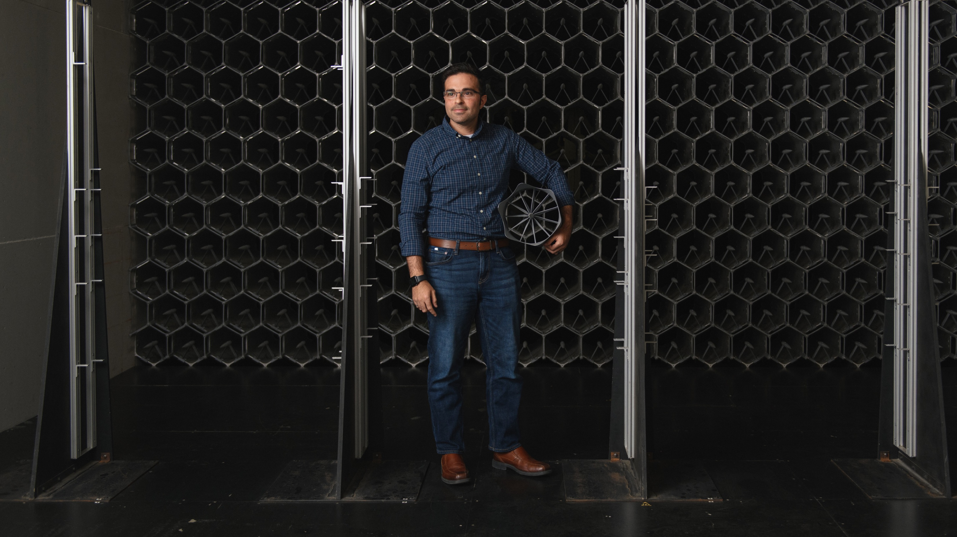
Your IFAS Partners for Technology Solutions
IFAS Information Technology
Andrew Carey
Director of Information Technology
http://it.ifas.ufl.edu
http://Helpdesk.ifas.ufl.edu

Slide 2

Getting IT Support in IFAS
2

Slide 3
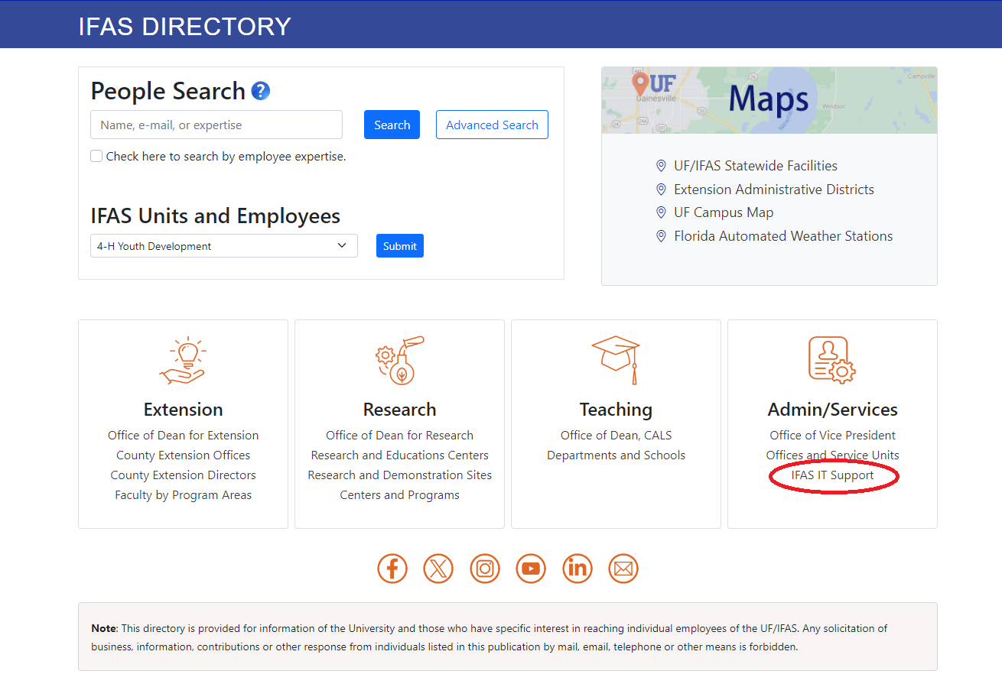

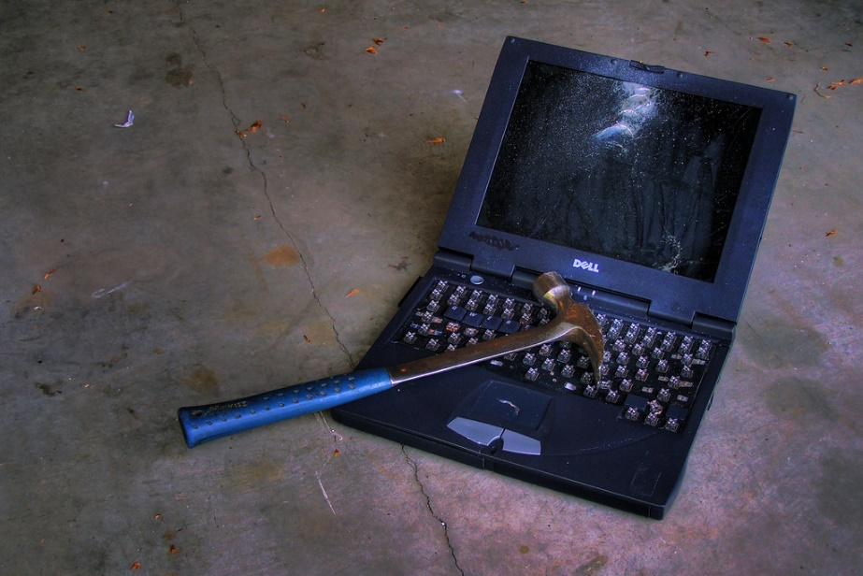
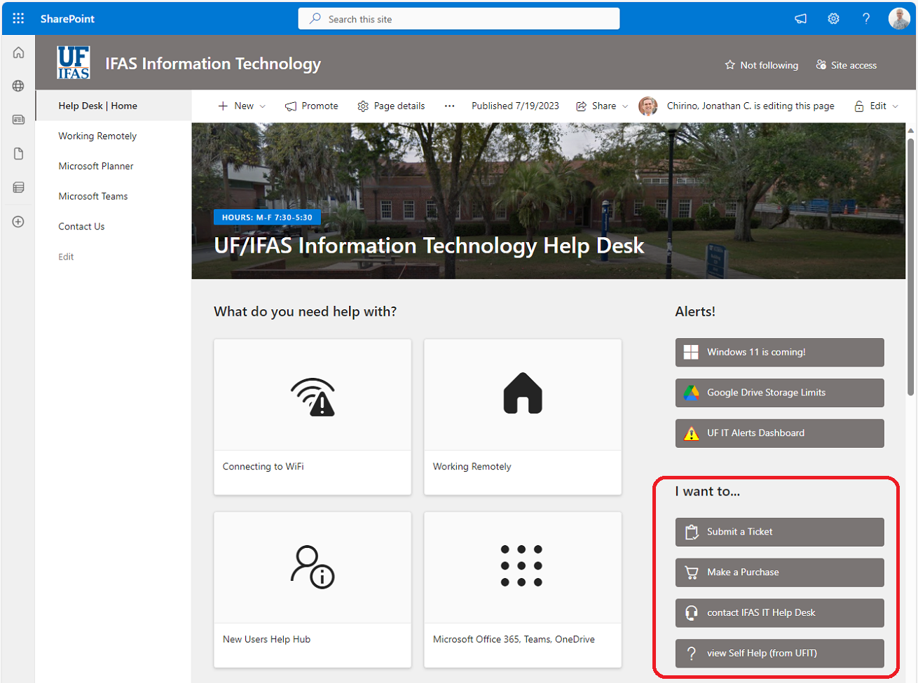
Getting IT Support in IFAS
Contact your departmental IT person
To find out who your departmental IT person is, Click on the IFAS IT Support link at http://directory.ifas.ufl.edu
Go to http://helpdesk.ifas.ufl.edu to find instruction guides, answers to common problems or to submit a ticket
Contact the IFAS IT Helpdesk
Email help@ifas.ufl.edu or
Call 352-392-4636
3

Slide 4

Computer & Software Purchases
4

Slide 5

Computer & Software Purchases
Contact your departmental IT person or the IFAS IT Helpdesk before making a technology purchase!
UF IT Policy specifies that all Information systems (computers, software, and other internet / network connected devices) must be assessed for risk to the University of Florida.
Your departmental IT person and the IFAS IT team can help you navigate the risk assessment process to increase the likelihood that your purchase will be approved and reduce the amount of time spent on the risk assessment process.
Departmental IT and IFAS IT Staff can help direct you to approved vendor portals to ensure you receive the best price on your computer or software purchase.
Departmental IT and IFAS IT Staff can advise you on the best technologies to meet your needs and budget.
5
This Photo by Unknown Author is licensed under CC BY

Slide 6
File Storage Options
6

Slide 7
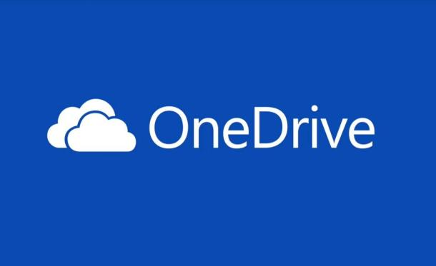




File Storage Options
Use OneDrive for files that only you need to work with
Use Teams for files that your group or team needs to work with together.
Use Shared Drives for very large data sets (25TB+) and files (250GB+) as well files that are constantly being read / written (database)
IFAS Departmental
& Group Shared
(Mapped) Drives
The University also provides access to Dropbox and Google Drive.
More information on those services at http://cloud.it.ufl.edu
7

Slide 8
File Storage Options
DON’T:
Store UF/IFAS data in non-approved storage locations
  includes personal / non-UF subscriptions to Google, Dropbox, iCloud, etc.
Store shared lab, department, or team data in OneDrive.
  Especially important if you have students producing content and data for you.
Store data on your computer hard drive.
  Computers can break or be lost / stolen
DO:
Contact your departmental IT person or the IFAS IT Helpdesk for help in choosing the right storage location for your data
Store UF/IFAS data in UF approved or provided file storage locations and services.
Use UF approved cloud services for easy access to your data and data backups
8

Slide 9
Email Tips and Tricks
9

Slide 10
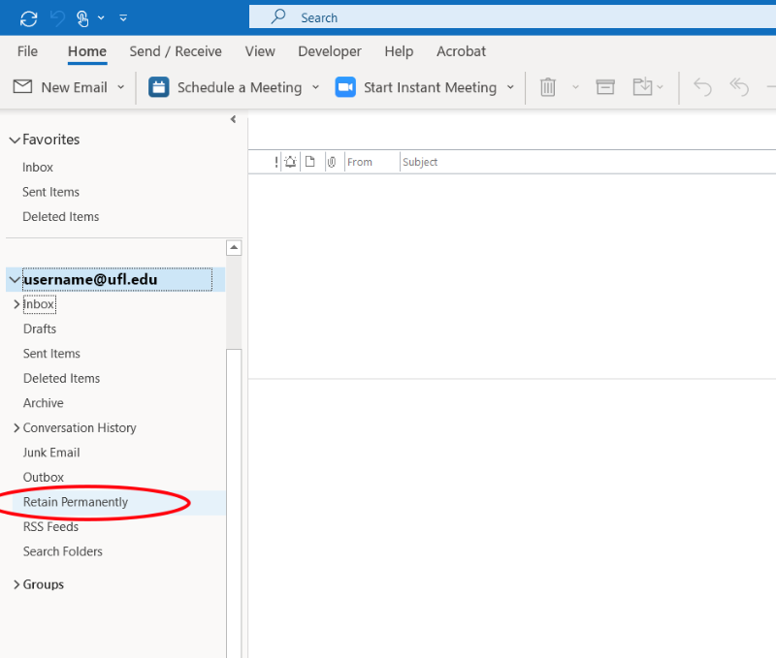
Email Tips and Tricks
Email Retention Policies
Email in your Inbox or Sent Items folders, or a subfolder of those folders will be deleted three years after being received.
Create a Retain Permanently Folder that is not under the Inbox or Sent Items folders and move emails that need to be kept to that folder
https://www.mail.ufl.edu/managing-email/retain-your-email/
10

Slide 11
Email Tips and Tricks
Keep Work and Personal Email, Calendar, Contacts and Files separate
After leaving the University your UF email, calendar, contacts and files in OneDrive are deleted after 30 days.
11

Slide 12
Resources & Questions
IFAS IT Helpdesk
http://helpdesk.ifas.ufl.edu
help@ifas.ufl.edu
352-392-4636
Andrew Carey
Director of Information Technology
UF/IFAS
agcarey@ufl.edu
12

