Slide 1
Telling Your Story
Chris Vivian AVP, UF/IFAS Communications
cvivian@ufl.edu

Slide 2
The single biggest problem in communications is the illusion that it has taken place.
George Bernard Shaw

Slide 3
Why? UF/IFAS Strategic Plan (2022)
https://ifas.ufl.edu/media/ifasufledu/vice-president/docs/IFAS_StrategicPlan2022.pdf

Slide 4
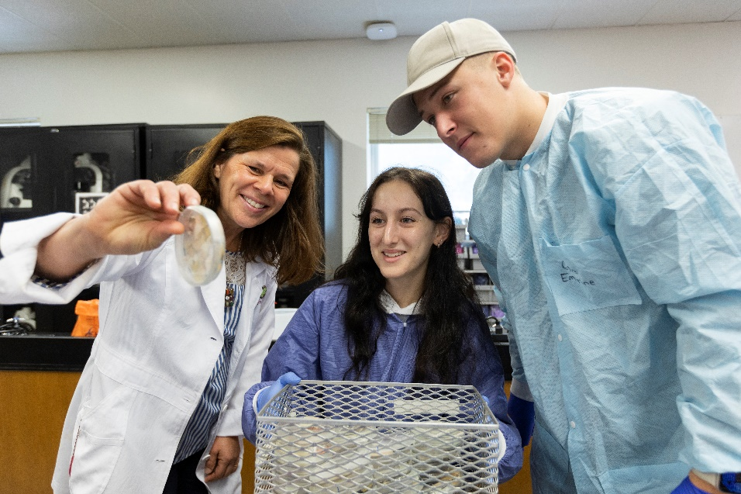
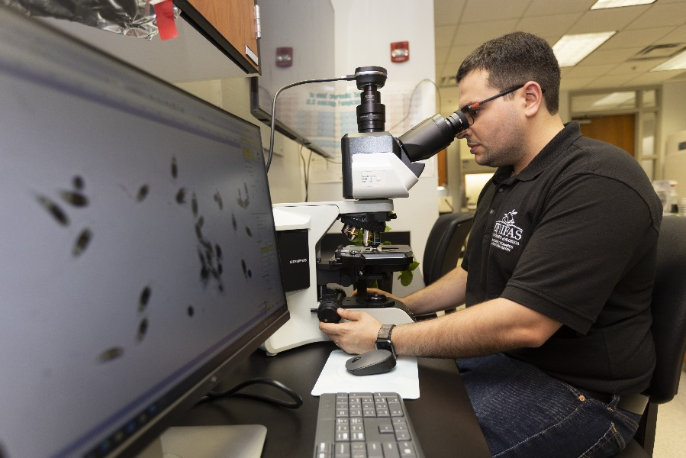
Story of UF/IFAS
One IFAS/many stories:
Research discoveries
Extension impacts
Education excellence
Everyone is a UF/IFAS ambassador

Slide 5
Working with your Communicator (or ICS)
Department communicator
Social media, newsletters, event promotion, website updating
Work with ICS for design, media, video, etc.
Let them know what you are doing/need
Bring them/us in early
“Us vs them”
Dept Comm or ICS can help:
Identify your audience
Tailor your message
Create outreach pieces and release
Collaborate for broader reach

Slide 6
Biggest Barriers
Too much info?
Who/what/when/where/how
Most important?
Call to action
Not enough info
Nobody knows about my program/work
Communicators brought in too late for best effectiveness
Notes:
Look at your current customer base.
Check out your competition.
Analyze your product/service.
Choose specific demographics to target.
Consider the psychographics of your target.
Evaluate your decision.
Additional resources.

Slide 7
UF/IFAS Branding
UF/IFAS logos
Promotional logos
Gator logo

Slide 8
Accessibility & Copyright
Accessibility in all efforts:
Proper colors
Screen readers
Captioning on video/audio
Use ONLY UF/IFAS, UF, or your own/department’s photos
No Googling images
Microsoft images must remain in Microsoft outputs (ppt, word, etc)
Creative Commons license are NOT always free to use
Edu does not mean everything is ‘educational’ and Fair Use
Departments are responsible to pay infringement fees

Slide 9
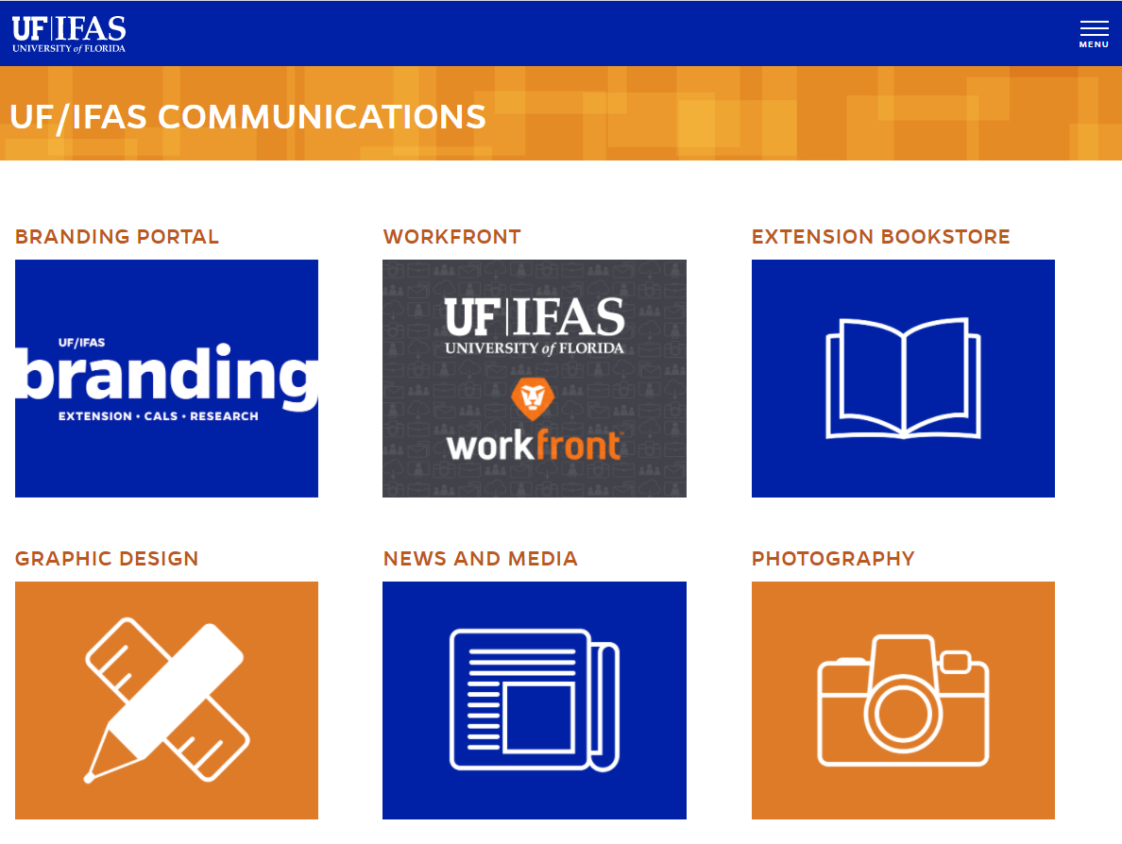
ICS Services
Platform support (web and blog)
Graphic design and templates
Media relations
Social media support and training
Professional photography
Professional video production
Branding/branding review
Accessibility Remediation
Requests via Workfront: https://ufifas.my.workfront.com/

Slide 10
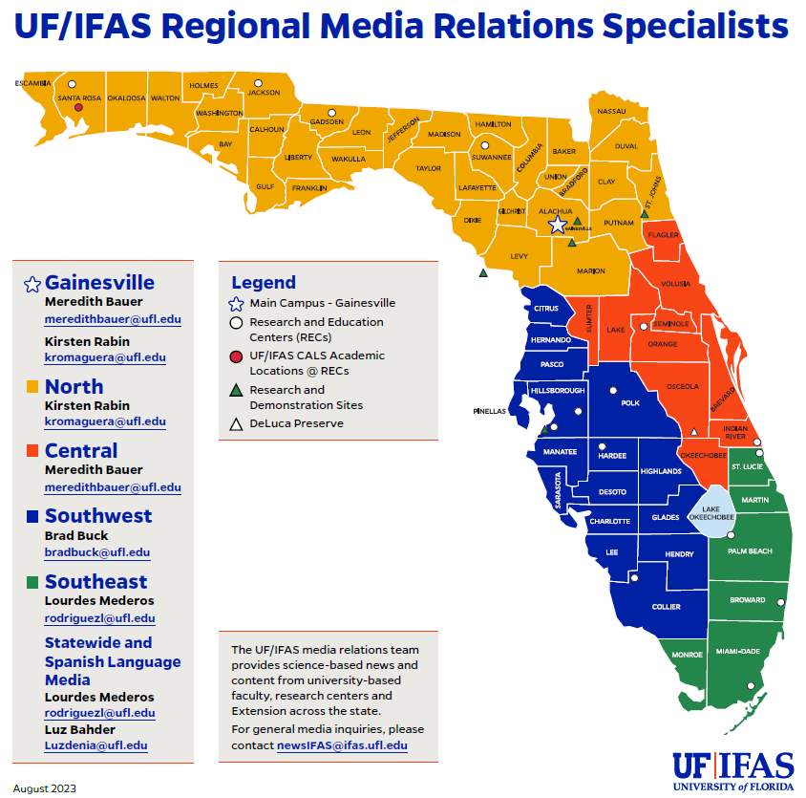
Working with ICS
UF/IFAS Communications’ charge:
Advance and protect UF/IFAS experts and expertise
Support Extension
What is Workfront? https://ufifas.my.workfront.com/

Slide 11
Resources
https://branding.ifas.ufl.edu/brand-guidelines/
IFAS photo database: https://photos.ifas.ufl.edu/
Photo usage guidelines
ICS social media help https://ics.ifas.ufl.edu/our-services/social-media/
Ask IFAS (EDIS) https://ask.ifas.ufl.edu
IFAS Branding website: https://branding.ifas.ufl.edu/

