Slide 1
FUNDRAISING 101
IFAS ADVANCEMENT
CODY HELMER- EXECUTIVE DIRECTOR
CHELMER@ UFL. EDU

Slide 2
MAJOR GIFT FUNDRAISING
What is major gift fundraising?

Slide 3
MAJOR GIFT FUNDRAISING REALITIES
Focus on donors capable of $100k gifts
Donor-centric fundraising
Donors have a passion for the cause
Relationship focused: 18-24 month “cycle” of giving

Slide 4
MAJOR GIFT FUNDRAISING
Buckets and Wells
We can lay out 1000 buckets
(We have endless options for giving)
We can use one well
(Focus on the best prospects and their intent)

Slide 5
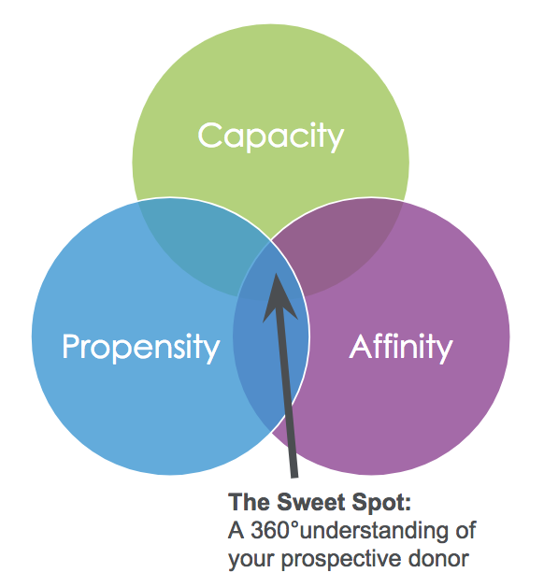
MAJOR GIFT FUNDRAISING

Slide 6
IFAS ADVANCEMENT OFFICE
Mission Statement:
IFAS Advancement fosters essential relationships and secures private support to advance the UF/IFAS land-grant mission.
UF/IFAS Advancement 1445 Date Palm Drive
Phone: (352) 392 1975
https://give.ifas.ufl.edu
Five frontline fundraisers and five support staff- serving IFAS

Slide 7
PARTNERS IN FUNDRAISING
Donor relations- many asking few
Maximize the ask- $10k often or $100k once
Strategy- what motivates the donors? Intent to help or tax incentives?
Policies: University naming policy, IRS rules
Stewardship, recognition, President’s Suite

Slide 8
PARTNERS IN FUNDRAISING
Introduce us to your stakeholders
Tell us about your projects
Identify new potential donors- listen for:
“I am interested in supporting…”
“I want to help”
“How can I help?”
We will never ask you to ask for money!

Slide 9
PARTNERS IN FUNDRAISING
Building a Campaign:
Create a plan
Know your audience
Engage your prospects
Strategize with Advancement
Make giving easy
When in doubt, ask

Slide 10
DEVELOPMENT 101
Questions?

