Slide 1
UF/IFAS New Faculty Development
UF/IFAS Extension
Andra Johnson, Dean and Director

Slide 2
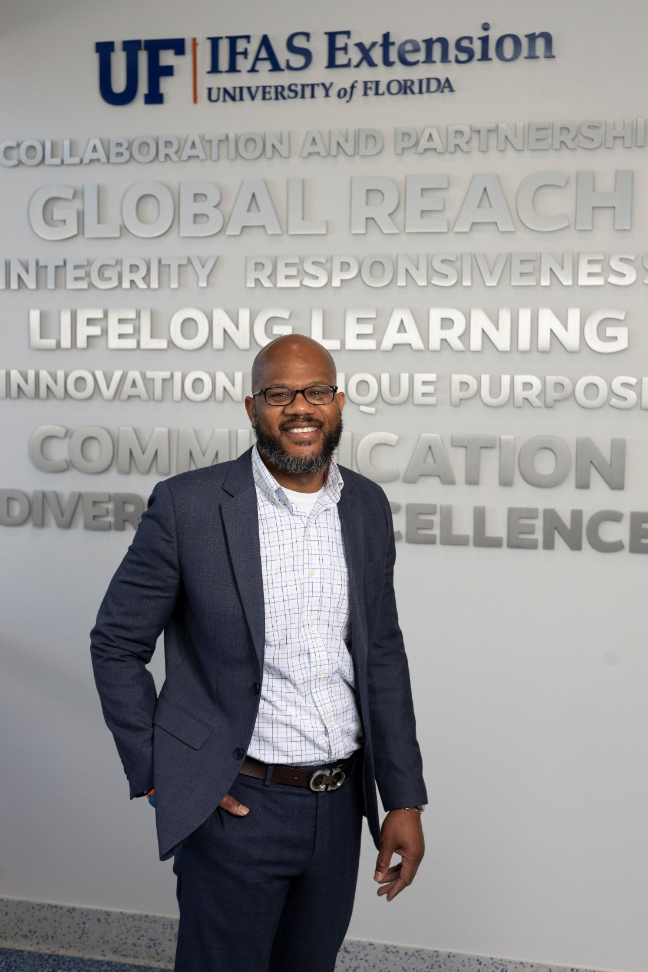
Meet the Dean: Andra Johnson
Professional Background
Dean and Director of Cooperative Extension UF/IFAS
Associate Director of Cooperative Extension The Pennsylvania State University College of Agricultural Sciences (University Park, PA)
Vice Chancellor for Research and Technology Development Southern University Agricultural Research and Extension Center (Baton Rouge, LA)
Assistant Research Director and Director of Graduate Research Alcorn State University (Lorman, MS)
Professor of Urban Forestry Southern University and A&M College and Agricultural Research and Extension Center (Baton Rouge, LA)
EDUCATION
Ph.D. Forest Resources with an emphasis in Urban Forestry: The Pennsylvania State University; University Park, PA
M.S. Forest Resources with an emphasis in Urban Forestry: The Pennsylvania State University; University Park, PA
B.S. Urban Forestry Management: Southern University A & M College; Baton Rouge, LA

Slide 3
Why was the National Cooperative Extension Created?
First Vision of Cooperative Extension’s Core Mission
The primary economic aim of simultaneously…
Producing “cheap food” for consumers and American industry, and…
Raising farmers’ incomes by bringing science to agriculture to make it more efficient and productive.

Slide 4
Why was the National Cooperative Extension Created?
Second Vision of Cooperative Extension’s Core Mission
Build a rich, vital, democratic culture by pooling scientific knowledge with local knowledge and experience in cooperative educational work to develop the full-range of people’s individual and community capacities and well-being.

Slide 5
Extension is:
Teaching people…
in their own context
how to assess their own needs and problems
Helping people…
acquire knowledge and skills
make science-based decisions and solve problems
Inspiring people…
to take action

Slide 6
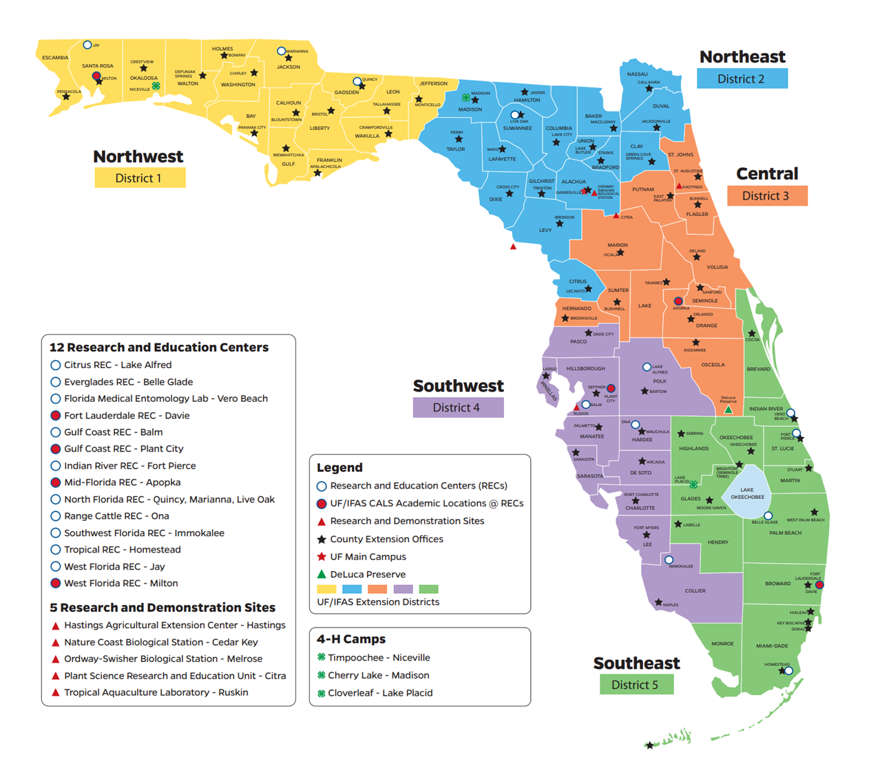
Statewide Presence
Offices in 67 FL Counties & Seminole Indian Tribe
17 Research and Education Centers & Demonstration Sites
3 4-H Camping Facilities
650 County and State Faculty located throughout the state

Slide 7
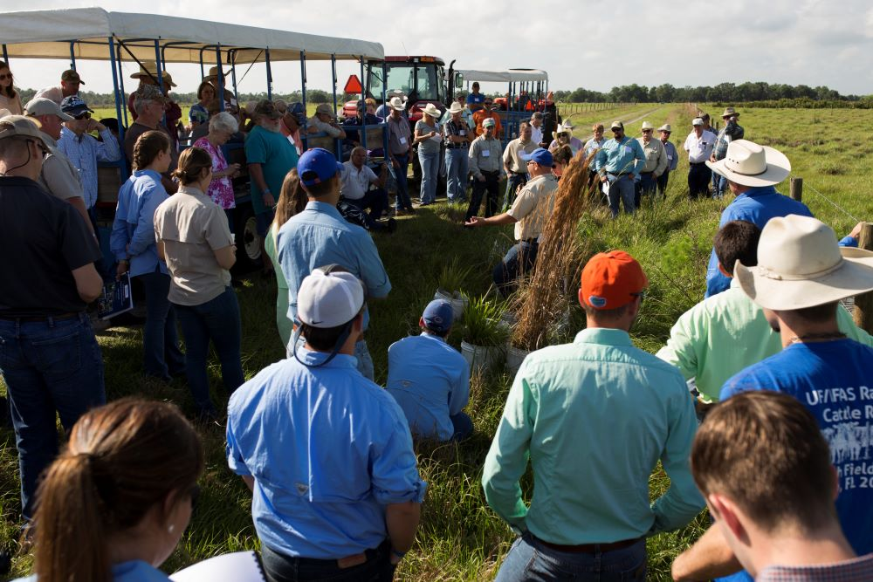
Our Strengths
We are emergency responders addressing threats from invasive species, animal diseases, insect borne pathogens, threats to crops, water quality, healthy living, all the way to economic downturns.
We serve as impartial and trusted facilitators bringing together diverse groups –with expertise to address complex issues.
Notes:
We work as emergency responders on many issues.

Slide 8
Our Strengths
We implement evidence-based family and youth programs – such as 4-H – that teach leadership skills and reduce juvenile delinquency, drug use, and other risky behaviors in our youth.

Slide 9
Our Strengths
We partner with federal, state, and county governments, and we have a long tradition of bringing unbiased support and education to the citizens and communities across the country.

Slide 10
Our Strengths
We work closely with Florida agriculture and industries to provide research, education, best practices, and support to enhance sustainability and profitability and help them address regulatory compliance challenges.
Notes:
Our strengths are not only what we do, but how we do it.
We work directly with industry and communities as drivers of economic development – their priorities are our priorities.

Slide 11
Challenge of Change
Changing demographics
Changing agricultural conditions
Changing marketplace and competition
Changing communication technologies
Changing consumer roles and expectations
Changing funder expectations
Changing institutional expectations
Notes:
Demographics - Average age of principal farmer in US - Ag Census 2012 – is 58.3 years old
Changing marketplace – much more competitive - information is available literally at your fingertips;
Changing technologies – Digital: Graduating generations of students who do not know life without the internet. 70% access to internet – increasing every year – and that is just farmers – other aspects of ag is higher – manufacturing, processing
Changing customer expectations -
much more competition for fed and state appropriations – not an entitlement – need to address issues with broad scope and high impact with fewer boots on the ground – how do we do that? Need to have counties value the organization beyond just the boots on the ground in that county. Assets of the organization /expertise as a whole.

Slide 12
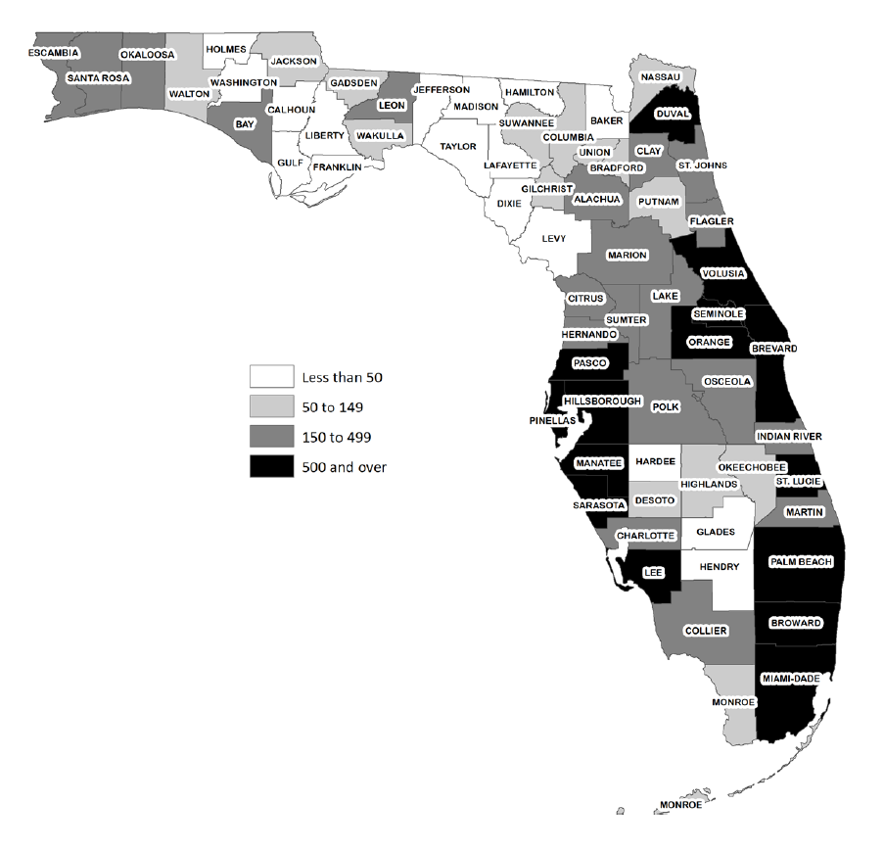
Population per square mile, 2022
22+ million people
3rd largest state in the USA
30 million projected by 2050

Slide 13
Priorities
Customer Centric:
Faculty
Relevancy
Responsiveness
Accountability
Trust

Slide 14
Our Approach
Respect the dignity of people
Co-create with community
Collaborate internally
Collaborate externally as conveners
Navigate tensions thoughtfully
Learn continuously

Slide 15
Mission & Vision
Vision:
“To be a leading provider of research-based solutions that empower individuals, families, and communities to improve their quality of life, while creating a sustainable future.”
Mission:
“Florida Cooperative Extension partners with communities to provide quality, relevant education, and research-based expertise to foster healthy people, a resilient environment, and a strong community.”

Slide 16
UF/IFAS Extension Roadmap, 2013-2023
Initiative 1: Increasing the sustainability, profitability, and competitiveness of agricultural and horticultural enterprises
Initiative 2: Enhancing and protecting water quality, quantity, and supply
Initiative 3: Enhancing and conserving Florida’s natural resources and environmental quality
Initiative 4: Producing and conserving traditional and alternative forms of energy
Initiative 5: Empowering individuals and families to build healthy lives and achieve social and economic success
Initiative 6: Strengthening urban and rural community resources and economic development
Initiative 7: Preparing youth to be responsible citizens and productive members of the workforce

Slide 17
Extension Administration Team

Slide 18
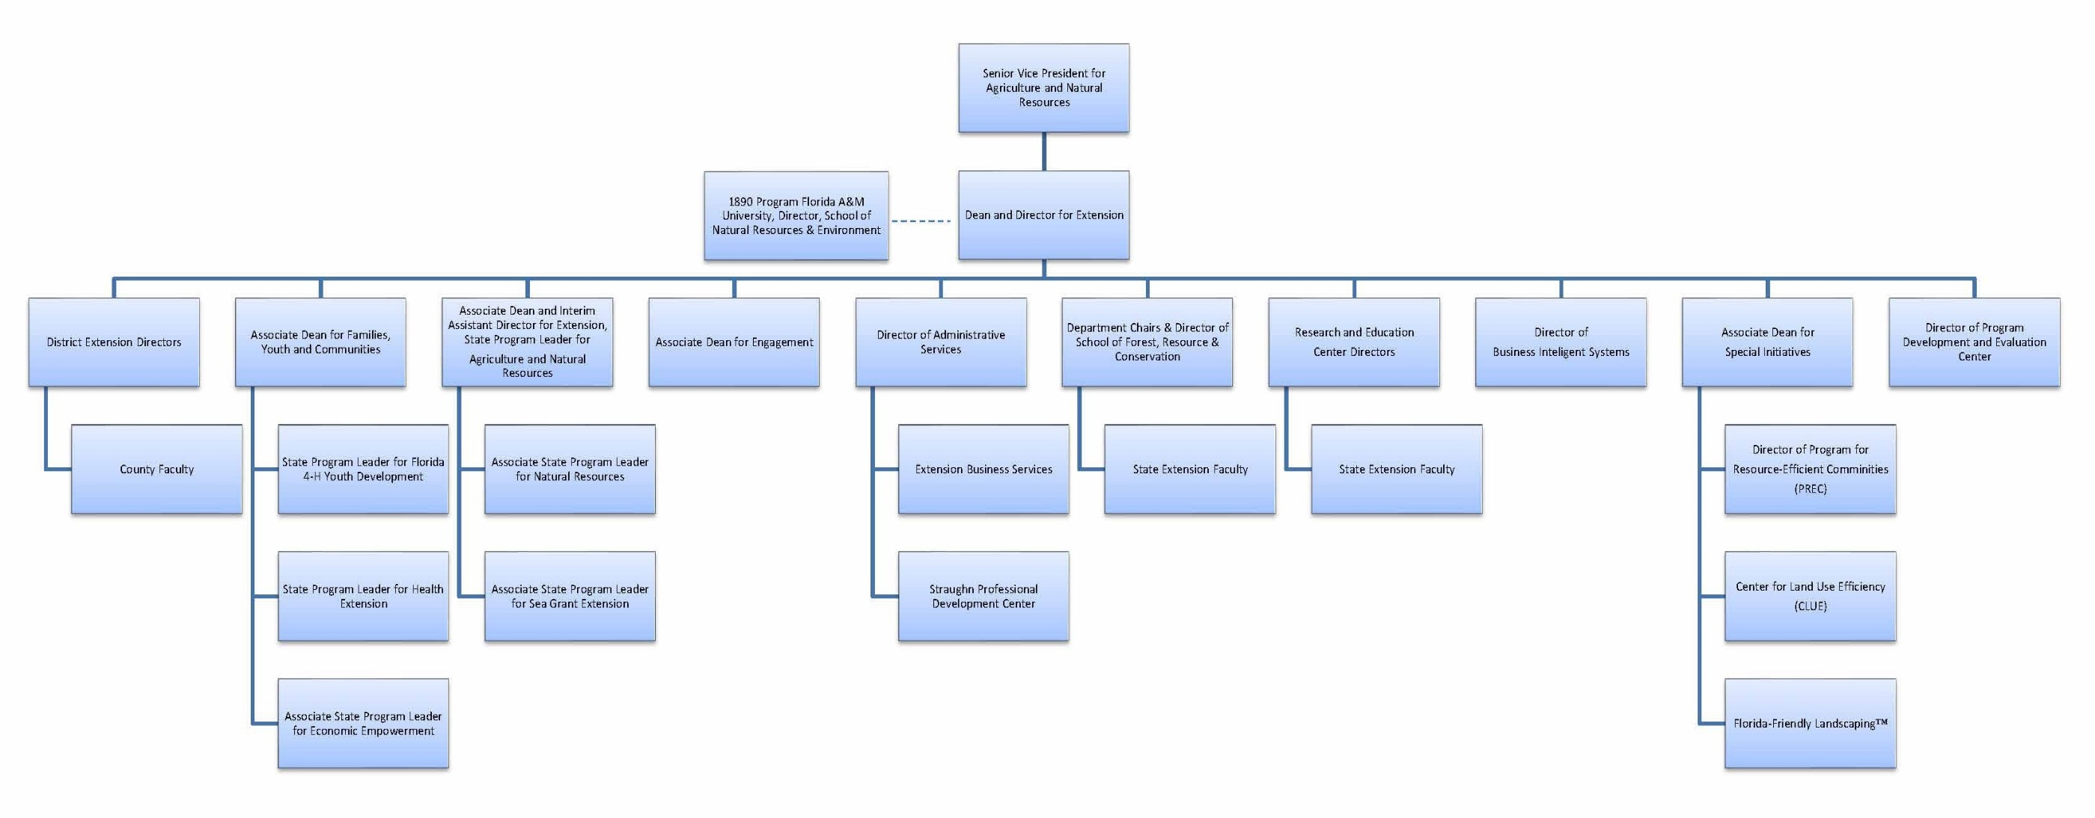
Extension’s Organizational Chart
8/22/2023

Slide 19
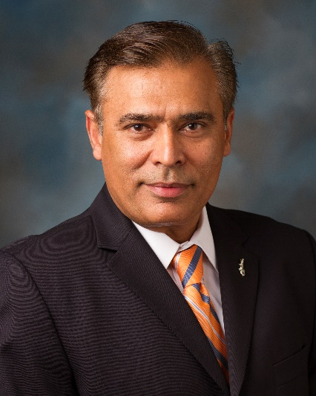
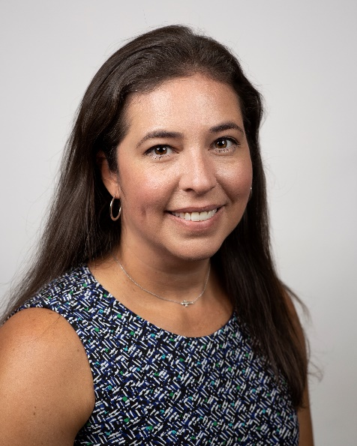
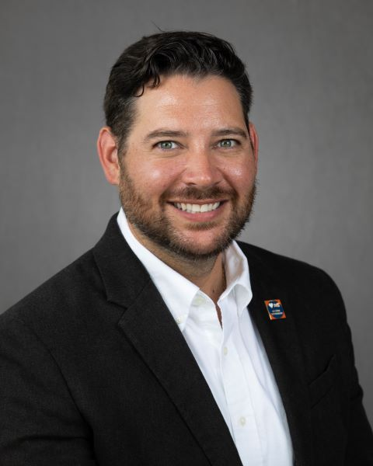
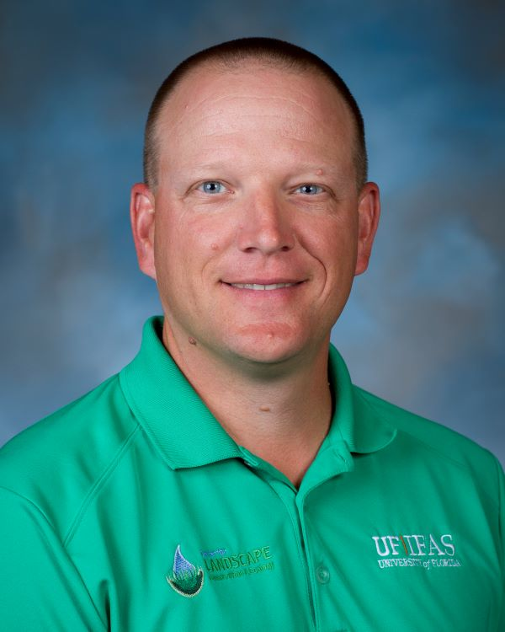
Extension Associate Deans
Saqib Mukhtar
Associate Dean & Interim Assistant
Director for Extension, State Program
Leader for Agriculture and Natural
Resources
Karla Shelnutt
Associate Dean for
Extension Engagement
Michael Dukes
Associate Dean for Extension
Special Initiatives
Christian Christensen
Director, Business Intelligence Systems

Slide 20
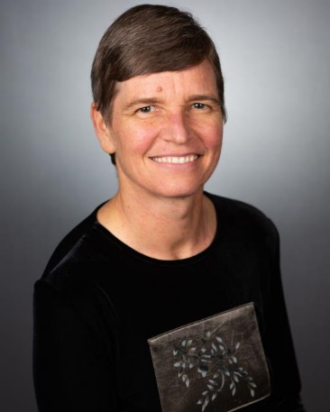
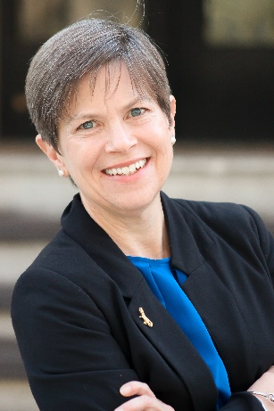
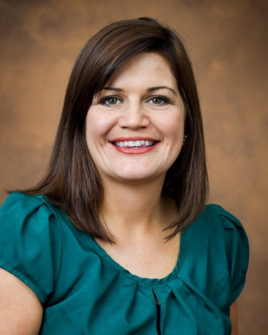
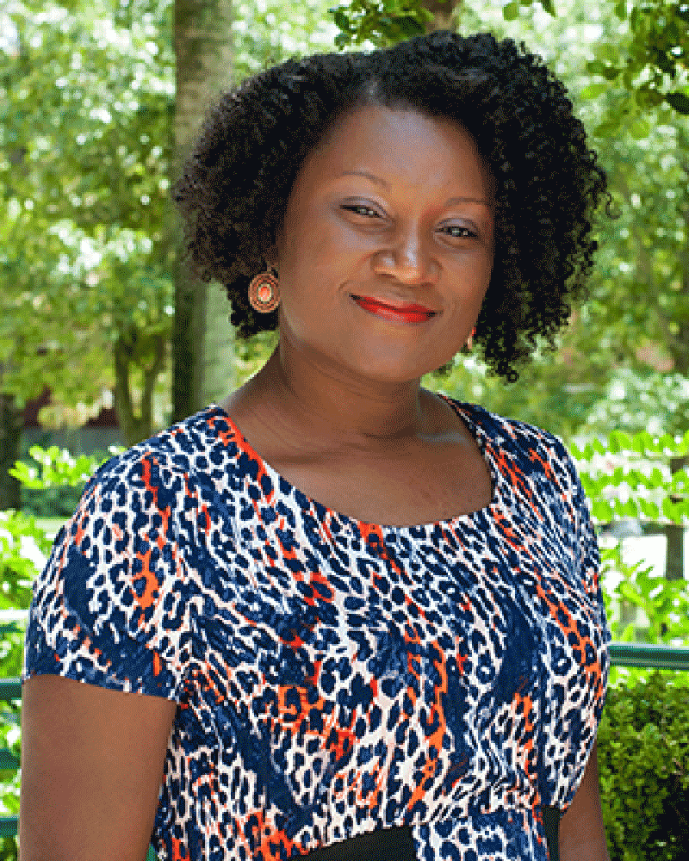
Extension Program Leaders
Stacy Ellison
State Program Leader
For 4-H Youth Development
Maia McGuire
Associate Program Leader for
Marine and Coastal
Extension, and
Florida Sea Grant Associate Director for Extension and Education
Shirley Baker
Associate Program Leader
for Natural Resources Extension
Latoya O’Neal
State Program Leader
For Health Extension

Slide 21
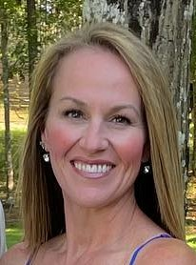
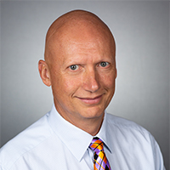
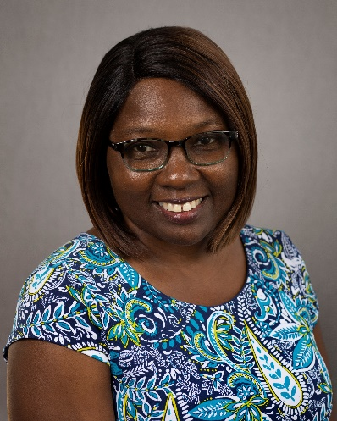
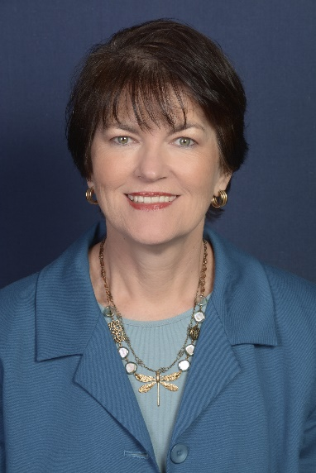
District Extension Directors
Julie Dillard
Northwest District
Extension Director,
Professor
Eric Simonne
Northeast District
Extension Director,
Professor
Norma Samuel
Central District
Extension Director,
Professor
Brenda Rogers
Southwest District
Extension Director,
Extension Agent IV
Anita Neal
Southeast District
Extension Director,
Extension Agent IV

Slide 22
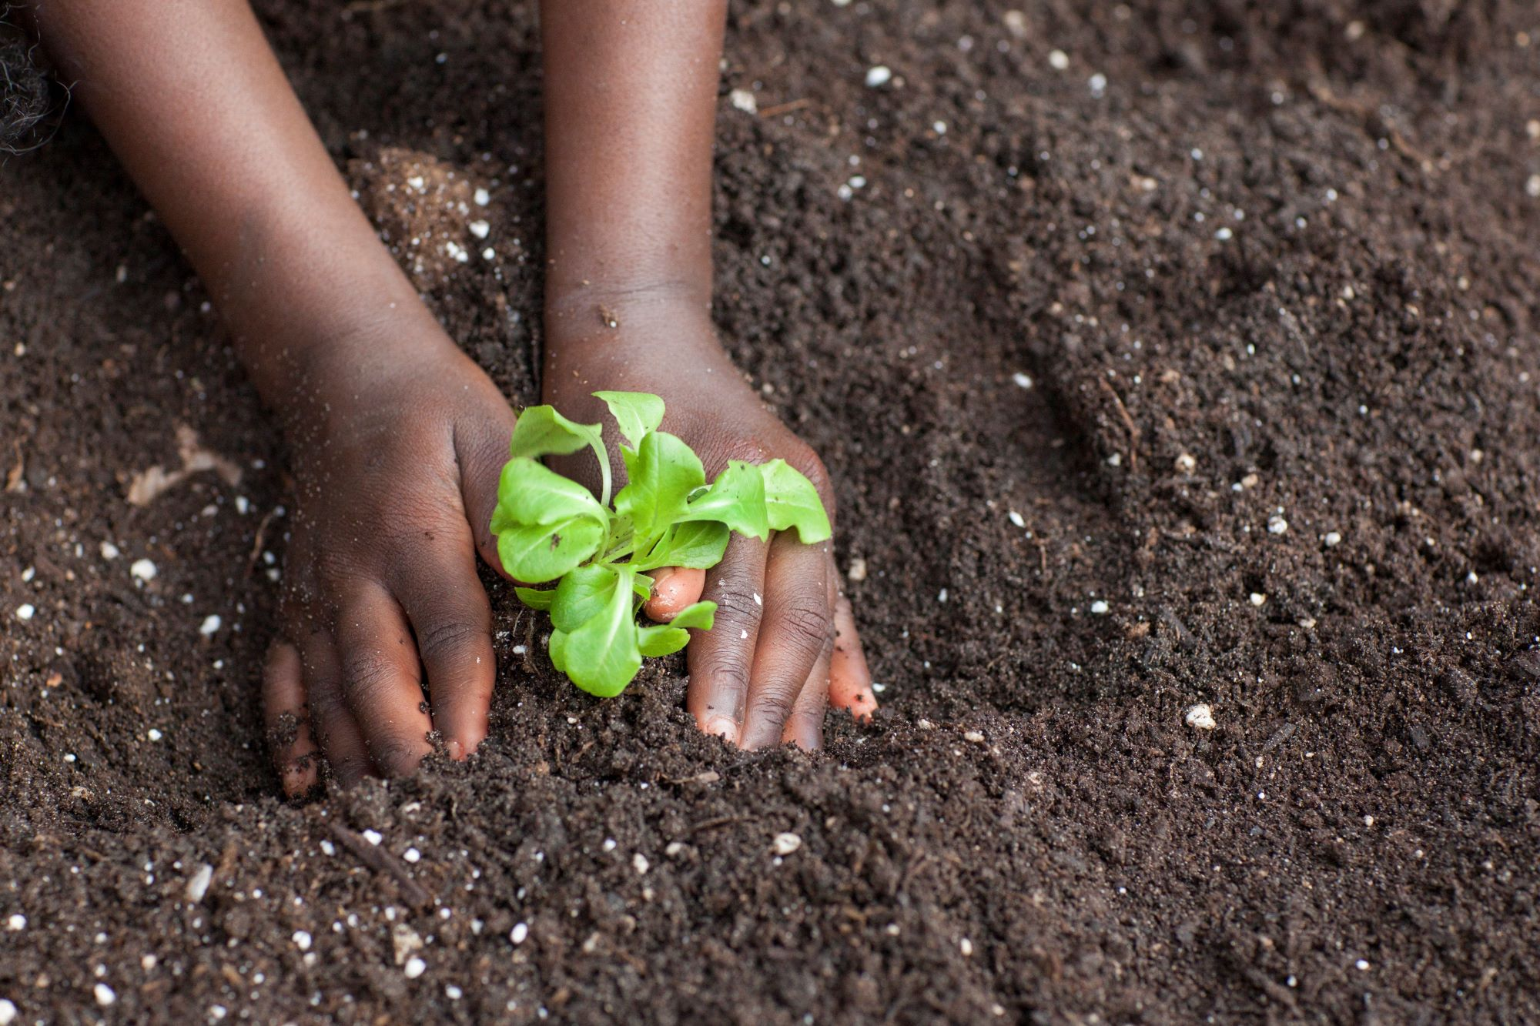
“You must be able to take the new thing you’ve learned today and build upon what you learned yesterday to keep growing.” — John C. Maxwell

Slide 23
In conclusion
Let us know how we can help you be most successful!
You are our most valuable asset!
Welcome to UF/IFAS!

