Slide 1
Add slide title here
September 20
2023
DR. JEANNA MASTRODICASA
UF/IFAS Operations Overview
Chief Operating Officer & Senior Associate Vice President for Agriculture and Natural Resources
UF/IFAS

Slide 2
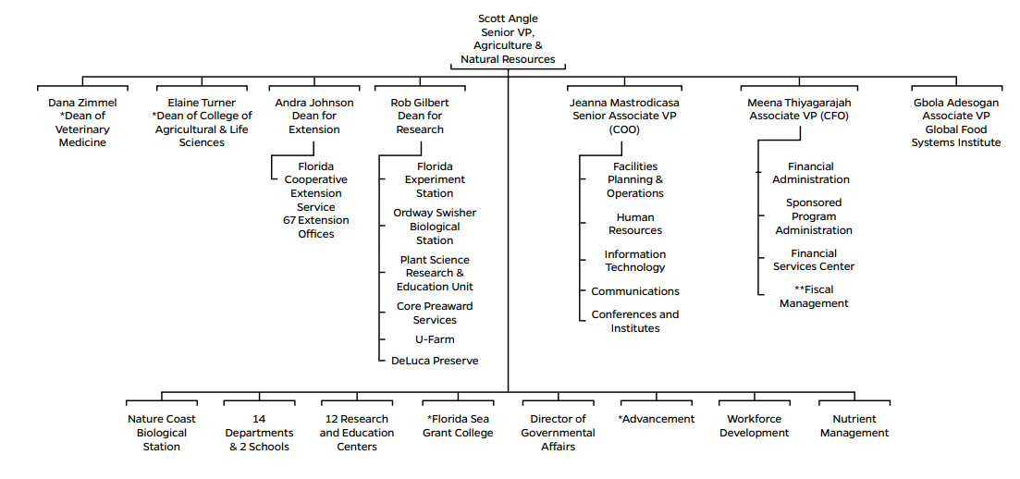

Slide 4
UF/IFAS OPERATIONS

Slide 5
UF/IFAS Operations
JEANNA MASTRODICASA COO
RONNIE COOPER Facilities, Planning and Operations
ANDREW CAREY Information Technology
MELISSA LONG Human Resources
CATHERINE CIMINILLO UF Employee Relations
BETH MILLER-TIPTON Conferences and Institutes
AMANDA BURKETT
Associate Director
GOLDIE KING Executive Assistant
CHRISTINE VIVIAN
Communications Services

Slide 6
WHO FIXES MY UF FACILITIES?
IFAS-OWNED & MANAGED
UF-OWNED & MANAGED
Buildings on the main UF campus (southwest corner) are IFAS-owned and managed, and all off campus properties (Research and Education Centers, etc.). These properties are maintained by UF/IFAS Facilities, planning and Operations (approximately 4M GSF.
Work Order: http://fpo.ifas.ufl.edu/
IFAS “rents” 15 buildings on main UF campus for 549,000 GSF. These buildings are maintained by UF’s Facilities Services. These buildings are in the core of UF campus: McCarty Hall, Frazier-Rogers Hall, Newins-Ziegler Hall, and Food Science and Human Nutrition are examples.
Work Order: https://www.facilitiesservices.ufl.edu/facility-maintenance-and-project-request/

Slide 7
HOW TO IMPROVE YOUR SPACE
What you can do!
Spend funds you control: use your start up package or indirect cost returns
Pay for equipment upkeep and apply for equipment grants
Leverage those dollars with matches from your department
Clean up your lab and/or office; ask for assistance like dumpsters or disposal of equipment
Identify underused space to your unit leader.

Slide 8
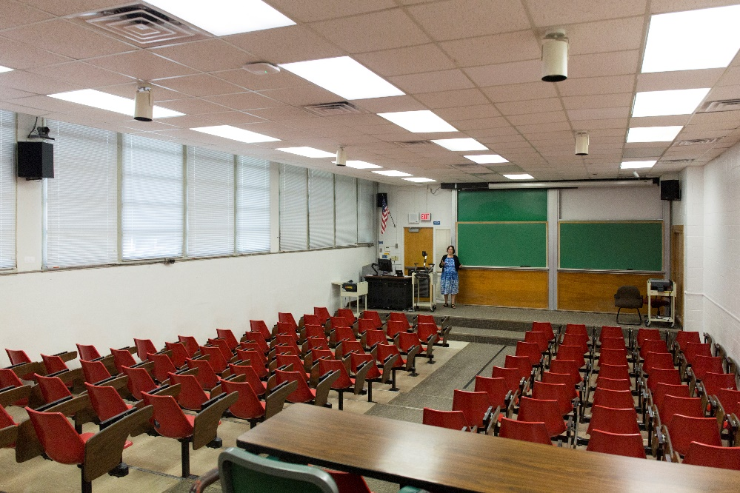
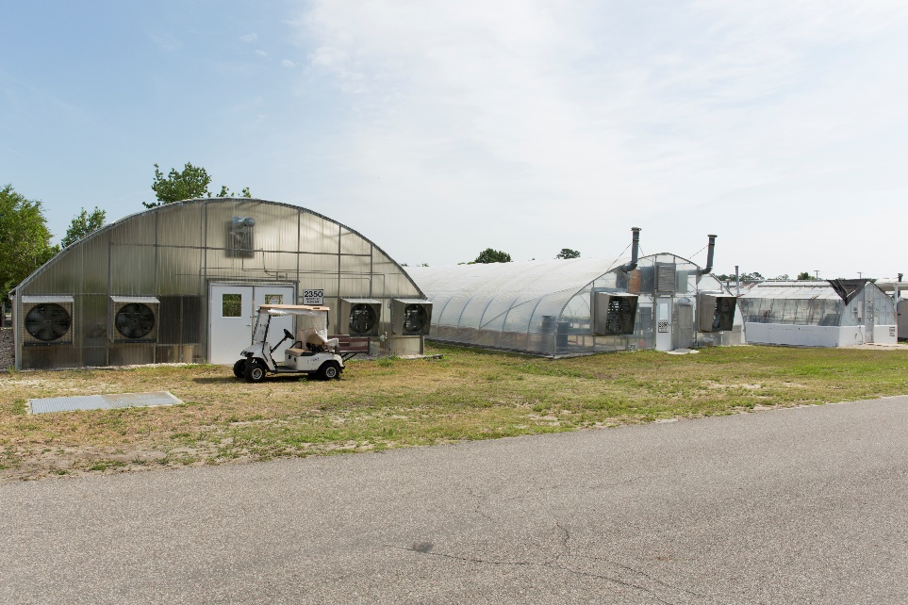
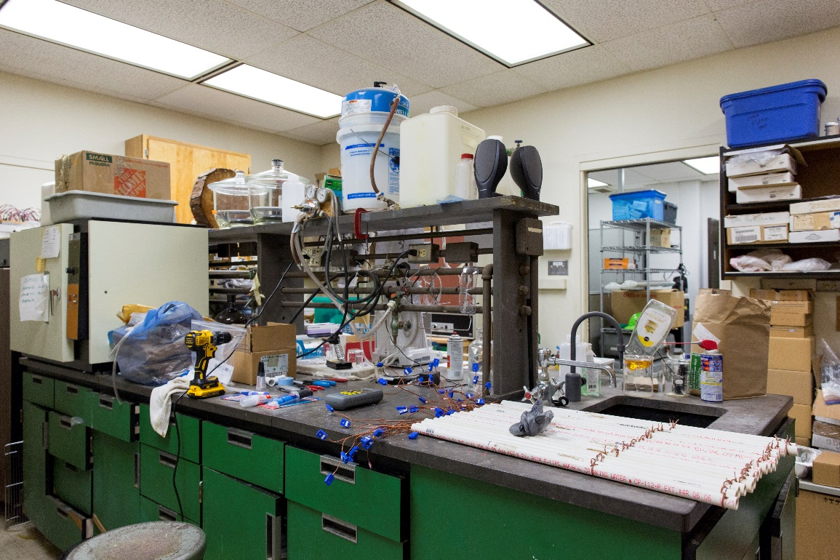

Slide 9
LOBBYING AND OTHER GOVERNMENT ACTIVITIES
LET MARY ANN HOOKS HELP YOU!
If you get a call from…
An elected official
A staff member for government
A reporter on a political topic…
CALL MARY ANN HOOKS!
Remember, there are PROHIBITIONS ON LOBBYING IN STATE GOVERNMENT IN FLORIDA
Mary Ann Hooks
Director of UF/IFAS Government Relations
mahooks@ufl.edu
(850) 322-7259

Slide 10
HOW TO BE A GOOD UF/IFAS CITIZEN
HOT TOPICS AT UF/IFAS OPERATIONS
Being good stewards of university money
Spending, not hoarding, money
Turning in your receipts in a timely manner
State vehicles and boats
5. Under-used space
6. Approving time of supervisees
7. Extreme weather and emergency management
8. Public records

Slide 11
CONFLICT OF INTEREST POLICY AND REPORTING IN UFOLIO
SECTION TWO

Slide 12
UF CONFLICT OF INTEREST REPORTING
Website: https://coi.ufl.edu/
HOW TO DISCLOSE:
• Click on “new disclosure” on the website.
• Answer yes or no to all of the questions
• If you answer yes, then please upload supporting documents
• It will be reviewed by your supervisor; if approved it goes up for UF review
• International activities are especially reviewed these days
All employees will need to disclose outside activities through the UFOLIO system
Much more clarity on what is an “inside” activity and does not need to be disclosed
Requires annual review and reporting

Slide 13
DISCLOSE IN UFOLIO:
Categories:
(1) A financial interest or an activity you do for an outside entity (that is not part of your assigned UF duties) that could create a conflict of interest.
(2) Employment & Professional Services: Compensated or uncompensated outside employment, consulting, or other professional services related to your Inside Activities or Institutional Expertise.
(3) Leadership Roles: Compensated or uncompensated business, academic, or professional leadership roles related to your Institutional Expertise (e.g., an engineer serving on Board of Directors of National Society of Professional Engineers).

Slide 14
DISCLOSE IN UFOLIO:
Categories:
(6) Research Sponsors & IP Licensees: Any outside activity, financial interest, or management position in an outside entity that sponsors your UF research or licenses intellectual property/technology from UF.
(7) Expert Witness & Legal Consulting: Serving as an expert witness or legal consultant in the area of your Institutional Expertise or Inside Activities in a legal matter like a lawsuit or a potential lawsuit.
•
(4) Business with UF: Management positions or financial interests in outside entities that enter into contracts/agreements with UF (sales, services, leases, etc.).
(5) Outside Research: Overseeing or conducting any research in the general area of your Institutional Expertise that is not coordinated through UF or receiving any research resources or funding through any Entity other than UF.

Slide 15
DISCLOSE IN UFOLIO:
Categories:
(10) Public Office/Candidate: Running for public office or holding elected office (e.g. City Council, State Senate)
(11) Outside Teaching/Research/Service Appointments: Teaching, research, or other service appointments at other institutions, including serving as a visiting instructor, scientist, on temporary appointment, etc.
(8) IP Income: Receiving from an outside entity any royalties, licensing fees, or other income from patents, copyrights, or other intellectual property of $5,000 or more annually in the area of your Institutional Expertise.
(9) Classroom Works: Receiving income from works (e.g. textbooks, computer software or electronic or digital media) that you assign to students in your UF course/program.

Slide 16
DISCLOSE IN UFOLIO:
Categories:
Website: https://coi.ufl.edu/
(12) Writing/Editing: Writing or editing a publication related to your UF expertise, unless this activity is considered by your chair/dean to be part of your UF assignment/Inside Activities.

Slide 17
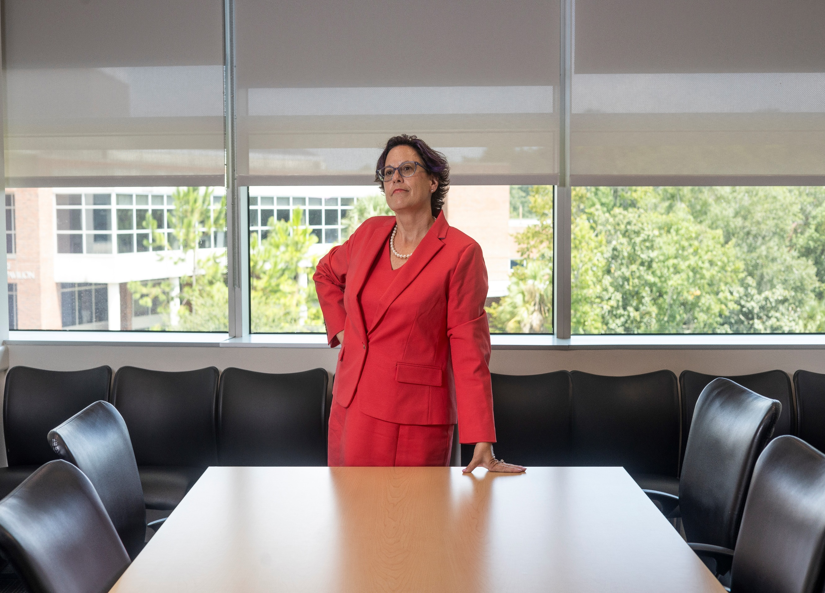
Contact:
Jeanna Mastrodicasa
jmastro@ufl.edu
352-392-1971
@drjtothemastro

