Slide 1
ePAF & Processing Training
Fall 2022
Office of Human Resources

Slide 2
Important links
IFAS HR Liaison Website
https://hr.ifas.ufl.edu/employees/ifas-hr-liaison/
UFHR New Hire Checklist
newhirechecklist.xlsx (live.com)
UF Payroll Schedule (Pay periods & deadlines)
https://www.fa.ufl.edu/directives/payroll-schedules/
Graduate Assistant/Fellowship Appointment Requirements (including min. salaries)
https://hr.ufl.edu/manager-resources/recruitment-staffing/hiring-center/preparing-an-offer/requirements-for-an-appointment/
Updated UFHR Employment Hub Website
Employment Hub – UF Human Resources (ufl.edu)

Slide 3
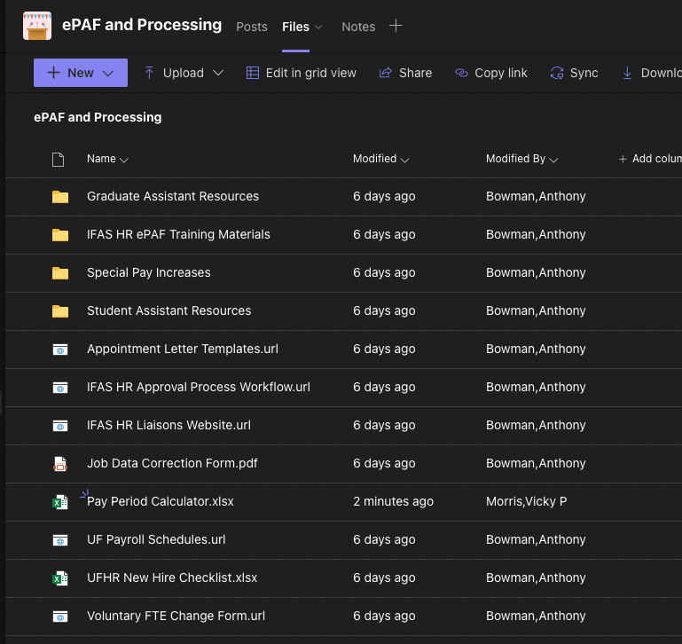
New Teams Channel
Under “IFAS Human Resources – Liaisons”
ePAF & Processing
Please check the “Files” sections for commonly used forms and useful links

Slide 4
SPI, Reclassifications, & FTE change reminders
Please ensure you are including the full chartfield with an SPI or voluntary FTE change requests. This includes faculty and post-docs.
Ex. 60460000-103-CRNNT (See department fiscal employee)
If you would like to change the title along with the salary for a TEAMS employee, this is considered a reclassification. To initiate, enter a position update ePAF and Katie Davison will process. This ePAF will pause at our level while we gather needed signature approvals.
If the employee is non-exempt (hourly) please use the hourly rates on the SPI form. Do not annualize the pay rate.
Online SPI Request Form:
https://forms.office.com/r/bNrnWfYYHn
Voluntary FTE Change form (TEAMS, Faculty, Post-Docs):
https://hr.ufl.edu/wp-content/uploads/2019/04/Voluntary_FTE-Change.pdf

Slide 5
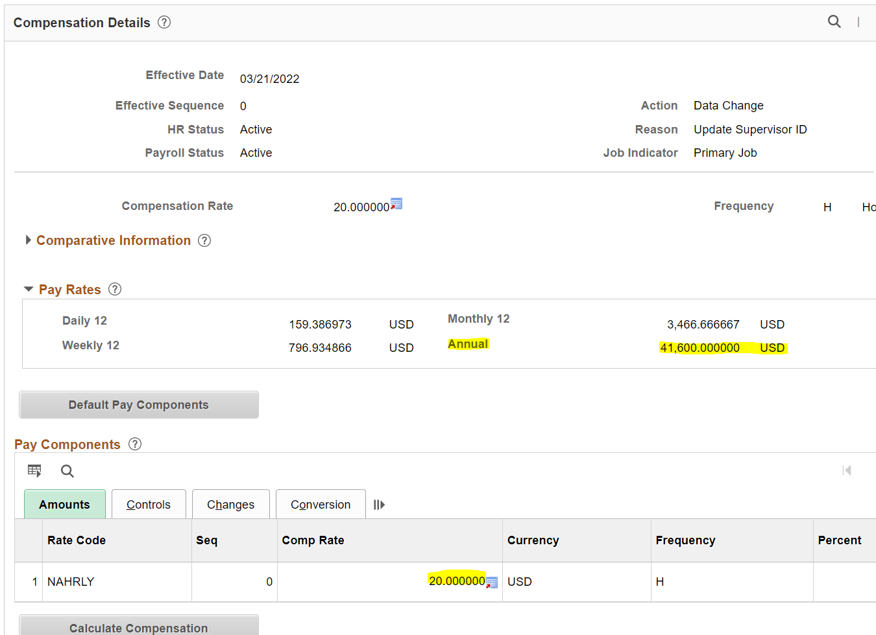
Job data annual rate error
Within Job Data, under the Compensation tab, there is an error that causes the “Annual Rate” to be incorrect under “Pay Rates”
In this example, the employee's compensation is $20 per hour. Job Data shows the annual rate to be $41,600. This is incorrect.
To calculate the correct annual rate, take $20 * 2088. The correct annual rate is $41,760.

Slide 6
Revised Offer Letter Procedure - TRE Splits
Updating Position Data via an ePAF prior to the faculty hire ePAF. Our office has been working with IFAS Financial Administration for several months on documenting the official assignment of faculty members. It has been decided that we will use the Position Summary page of the Update Position ePAF to document the TRE as well as include the duties and responsibilities from the position announcement. We expect to be able to run reports on this data, but it is critical that the data be entered exactly as noted in the guide sent out by Susan Hudson, including slashes, colons, comma, and periods.
NEW PROCESS:
Before entering the hire ePAF or faculty position update such as FTE change, title change, the unit must enter an ePAF to update Position Data:
Position number must be active.
Position title must be correct.
Add TRE to Summary of Position Roles & Responsibilities.
Use this EXACT format:
DOH:mm/dd/yyyy,T:0.00,R:0.00,E:0.00,A:0.00
Failure to use the exact format will result in the data not being able to be pulled into the report.
After the TRE, enter a space then add the Duties and Responsibilities from the Position Announcement. The standard, generic material should be deleted.

Slide 7
Hire ePAF Comments Reminder
Please indicate what type of hire the ePAF is for in the comments:
Faculty, TEAMS, STAS, OPS
Indicate if it is GA, Post-Doc, Adj Fac, etc.
For example, for a FA12 hire:
“FA12 Hire” or “12 month faculty hire”
Please indicate that a background check request has been initiated through First Advantage
Please add FirstAdvantage Order Number – this will make it easier to confirm
Please add a short description of job duties for OPS hires (Not needed for STAS)
Please attach Clearance for Hire email for TEAMS – this will help prevent recycles (clearance can clarify if certain licenses or other documentation is needed)

Slide 8
Workflow process chart
Please refer to the following chart for information on who in IFAS HR processes specific requests:
Approval-Process-Workflow-09-2021.pdf (ufl.edu)
Who to Contact list
Contact list 03-09-22.xlsx (live.com)

Slide 9
Common Issues
GatorStart not completed after 2 days – unit should be following up with employee
Will be recycled back to the unit after 2 days if GS is not completed. Will recycle immediately if there are missing documents or if something is incorrect.
Wrong OPS application submitted with EPAF’s
Ensure it is the most up-to-date version: https://hr.ufl.edu/forms-policies/forms-employees/
OPS has indication of relative’s working at UF but no nepotism form request
If there is a relative working within IFAS, please submit nepotism request to Janet Malphurs
Letter of offer does not match the information on the ePAF, such as:
Position number, title, FTE, effective date, and salary
Missing documents associated with the New Hire checklist
Ensure all documents are attached. Please do not attach unneeded documents such as an I-9. Please do not attach Word documents or outlook emails (.msg), export as PDF first
Faculty and TEAMS Medical Extended Leave of Absence do not have IFAS HR approval

Slide 10
Common Issues
Four-in-One Form not completed
This form must be notarized and attached before approval
The notary signature date and employee signature date must match in sections 1 & 2
IFAS HR requires this form for approval
Wrong offer letter used for current TEAMS person moving to a new job (such as promotion or new department)
Please use the correct template. They are located: https://hr.ufl.edu/manager-resources/recruitment-staffing/hiring-center/preparing-an-offer/appointment-letter-library/
Always use most recent letter
Transfer from box completed when not accurate
See ”ePAF Transfers” slide
Fellowship MOU not complete
Start/end dates must be on the form and must use effective date of current pay period
DO NOT add hours worked on the MOU

Slide 11
Common Issues
Missing letters of recommendation for faculty hires (3 letters are needed)
Transmittal letter/recommendation letters no longer needed for adjunct or post-docs
Foreign National Hire Process
Ensure the correct “Cit Status” is selected when entering the hire ePAF. “Non-Citizen National of the US” is rarely used. In most cases, it will be “Non-Resident Alien”.
See “Foreign National Hire Process” slide for more information
Position number may need to be updated to match title in letter of offer.
If a position update is needed, ensure that the effective date of the position change is prior to the start of the employment.
For example, “Ast/Aso/Prof” is used during the recruitment phase. This needs to be updated with a position update ePAF prior to the hire ePAF.
Missing Sanctions List Search for the foreign national hire
https://sanctionssearch.ofac.treas.gov

Slide 12
Common Issues
First Advantage – Background Checks
Please ensure the correct package has been selected
Please see IFAS HR training manual for more information. Package information is also listed when accessing First Advantage through myUFL
https://hr.ifas.ufl.edu/employees/ifas-hr-liaison/
Ensure that the candidate is aware of this process as they will have 6 days to fill out the initial screening. If they fail to do this, a new background check request will have to be submitted by the unit.
Add First Advantage order number to comment section
The “Clearance for Hire” email that is sent to the department will indicate the type of package to use.
If an ePAF is recycled back to the unit, please read the full comment and ensure all action items are completed before resubmitting. If this is not done, it can significantly delay the approval process.

Slide 13
First advantage packages
Basic+Edu+Empl Verf This package is specifically for Salary/Regular faculty, TEAMS, Adjunct, and PostDoc who are new or returning to UF. This type of check includes criminal screening within U.S., verifying highest level of education (including high school diploma), and validating employment history.
Basic+Edu+Empl Verf – Int’l This package is specifically for Salary/Regular faculty, TEAMS, Adjunct, or PostDoc hires who have not lived within the U.S. for the last three years. This type of check includes searching for criminal records in both U.S. and appropriate countries, verifying highest level of education (including high school diploma), validating employment history, and checking against global sanction lists, including U.S. terrorist list.
Basic This package is specifically for OPS staff, student, and graduate assistant hires new to UF. This package only searches for criminal records within the U.S.
(Optional) This package can be used to conduct criminal background check on UF employees transferring from one department to another on the same salary plan (i.e. TEAMS to TEAMS).
Basic – Int’l This packet is specifically for OPS staff, student, or graduate assistant hires who have not lived within the U.S. for the last three years. This package will search for criminal records within U.S. and appropriate countries.
Edu+Exp Verf This package is only for Salary/Regular faculty, TEAMS, Adjunct, and PostDoc hires who are new or returning to UF and will go through FBI/435 Livescan check. First Advantage will not be conducting FBI or 435 Livescan. Hiring departments will still need to conduct these types of checks through UFHR.
This package is also used for OPS staff, students, and graduate assistants hired into Salary/Regular faculty, TEAMS, Adjuncts, and PostDoc position.

Slide 14
Social security cards
U.S Citizens
If the social security card has been misplaced, a receipt can be attached to the hire for approval. It will need to be added to OnBase once it arrives for tax purposes.
The social security card does not need to be signed to be valid.
Foreign Nationals
If a temp ID is used in place of a social security card, please ensure once the social security card is issued that it is updated in the system:
https://hr.ufl.edu/manager-resources/employment-hub/employment-data/
ePAF’s
When creating a UFID prior to the hire ePAF of a new employee, be sure to verify the social security number has been entered within “Hire an Employee” during Step 3 under “Identity Information”. This will prevent delays in the approval process.

Slide 15
Foreign national (FN) hire process
Process
https://hr.ufl.edu/manager-resources/employment-operations-and-records/hiring-a-foreign-national/
Important Notes
After the ePAF is entered in order to generate the GatorStart packet, make sure to submit the FNIS Shell Request
Out of country degrees will need to have a NACES degree confirmation attached.
https://www.naces.org/
This is written into the offer letter. This may take a few weeks to complete.
Please do not attach paper I-9. It is done through GS.

Slide 16
Salaried Faculty
Required Documents
I-9 Supporting Documents
Social Security Card
Notarized Four-in-One (4-in-1) Form
Official Transcripts
Signed Letter of Offer
Resume or Curriculum Vitae (CV)
3 Letter of Recommendation OR if no search please use Letter of Transmittal
Sample Transmittal Letter: https://hr.ifas.ufl.edu/resources/form-index/
Procedure
ePAF can be submitted without documents to initiate GatorStart packet. IFAS HR will recycle back after 2 business days
First Advantage needs to be completed and if unable to verify education/experience, documentation will need to be attached to ePAF
https://hr.ufl.edu/wp-content/uploads/2018/04/experience_verify.pdf
Common Issues
Out of country degrees will need to have a NACES degree confirmation attached.
https://www.naces.org/
This is written into the offer letter. This may take a few weeks to complete.
Position number may need to be updated to match title in letter of offer.
If a position update is needed, ensure that the effective date of the position change is prior to the start of the employment.

Slide 17
Adjunct Faculty & Post-Docs
Required Documents
I-9 Supporting Documents
Social Security Card
Notarized Four-in-One (4-in-1) Form
Official Transcripts
Signed Letter of Offer
Resume or Curriculum Vitae (CV)
Letter of Transmittal no longer required for Post-Docs & Adjunct Faculty
Procedure
ePAF can be submitted without documents to initiate GatorStart packet. IFAS HR will recycle back after 2 business days
First Advantage needs to be completed and if unable to verify education/experience, documentation will need to be attached to ePAF
https://hr.ufl.edu/wp-content/uploads/2018/04/experience_verify.pdf
Common Issues
Out of country degrees will need to have a NACES degree confirmation attached.
https://www.naces.org/
This is written into the offer letter. This may take a few weeks to complete.
The minimum salary for Post-Docs is $47,476
The “Empl Class” will always need to be “Post-Doc Research” for benefits purposes.

Slide 18
TEAMS Hires
Required Documents
I-9 Supporting Documents
Social Security Card
Notarized 4-in-1 form
Signed Letter of Offer
https://hr.ufl.edu/manager-resources/recruitment-staffing/hiring-center/preparing-an-offer/appointment-letter-library/
Resume or CV
If not required on posting, please attach Careers at UF application
Procedure
ePAF can be submitted without documents to initiate GatorStart packet. IFAS HR will recycle back after 2 business days
First Advantage needs to be completed and if unable to verify education/experience, documentation will need to be attached to ePAF.
https://hr.ufl.edu/wp-content/uploads/2018/04/experience_verify.pdf
Common Issues
Ensure that background & education verification has been submitted through First Advantage.
Make sure that the position number matches between letter & ePAF.
A resume or Page-Up application is required for TEAMS hires.

Slide 19
OPS Temporary Hires
Required Documents
I-9 Supporting Documents
Social Security Card
Notarized 4-in-1 form
Signed OPS Application
Procedure
ePAF can be submitted without documents to initiate GatorStart packet. IFAS HR will recycle back after 2 business days
First Advantage needs to be completed and if unable to verify education/experience, documentation will need to be attached to ePAF.
https://hr.ufl.edu/wp-content/uploads/2018/04/experience_verify.pdf
In the ePAF comment section, provide a short description of job duties.
Common Issues
Check if the employee is registered for classes, and if so please hire as STAS.
The OPS application must have either a wet signature or a DocuSign signature. A typed name is not enough for the signature line.
If the nepotism question is answered yes on the OPS application and the relative is within IFAS, please contact Janet Malphurs.
We cannot approve if nepotism has not been pre-approved.

Slide 20
OPS Benefits Reminder
Ensure accurate FTE is reported for OPS new hires to avoid missed benefit enrollment opportunities.
All ‘newly hired’ employees reported with a .75 FTE will be flagged as being eligible to enroll in State of Florida benefits.
A 26-week break in State of Florida employment is required to be considered a ‘New Hire’.
Open Enrollment measurement period –
People First counts the number of hours worked between October 2021 through October 2022 to see if member worked on average 30 hours or more per week which determines benefits eligibility for the 2023 calendar year.

Slide 21
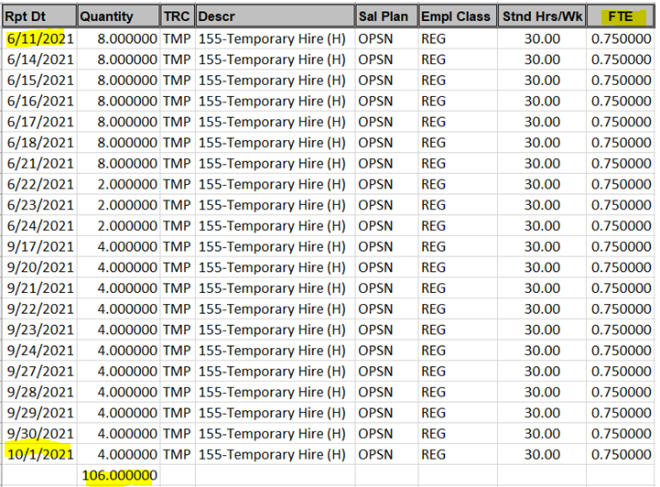
OPS Benefits Reminder
OPS member was hired with a .75 FTE during June 2021 then moved into a TEAMS position on January 3rd and was unable to enroll in benefits.
Based on hire FTE member was eligible to enroll in benefits during the New Hire election period.
Member then moved into a TEAMS position and was unable to enroll in benefits because the OPS hire .75 FTE.
IF IN DOUBT member will work on
Average 30 hours or more per week Consider reporting a .74 FTE.
Member will likely not work on average 30 hours or more per week during the measurement period.

Slide 22
Student Assistants/FWSP Hires
Federal Work Study Program (FWSP)
The purpose of Federal Work-Study (FWS) is to provide students with part-time employment to help meet college costs and, if possible, provide work experience in a related field
Processed the same as Student Assistants
For questions regarding the FWSP program, please contact Student Financial Aid (SFA): https://www.sfa.ufl.edu/contact-sfa/
Student Assistants
Required Documents
I-9 Supporting Documents
Social Security Card
Notarized 4-in-1 form
Signed OPS Application
Procedure
ePAF can be submitted without documents to initiate GatorStart packet. IFAS HR will recycle back after 2 business days
Common Issues
The OPS application must have either a wet signature or a DocuSign signature. A typed name is not enough for the signature line.
If the nepotism question is answered yes on the OPS application and the relative is within IFAS, please contact Janet Malphurs.
We cannot approve if nepotism has not been pre-approved.

Slide 23
Graduate Assistant Hires
Required Documents
I-9 Supporting Documents
Social Security Card
Notarized 4-in-1 form
Signed Letter of Appointment
Links to template letters:
https://hr.ufl.edu/manager-resources/recruitment-staffing/hiring-center/preparing-an-offer/appointment-letter-library/
Procedure
ePAF can be submitted without documents to initiate GatorStart packet. IFAS HR will recycle back after 2 business days
Must meet all minimum registration and salary requirements:
https://hr.ufl.edu/manager-resources/recruitment-staffing/hiring-center/preparing-an-offer/requirements-for-an-appointment/
Common Issues
Ensure that the start & end dates of the appointment follow the academic calendar. These dates can be found on the Payroll Schedule.
The Job Code must match between the letter and ePAF (e.g. GA-R, GA-T, GA RES AST)
The salary must meet all minimum and registration requirements.
The updated template letters must be used
https://hr.ufl.edu/manager-resources/recruitment-staffing/hiring-center/preparing-an-offer/appointment-letter-library/

Slide 24
Graduate Assistant Petitions
Process
A petition is a request for an exception to a current graduate education policy usually due to an unusual situation beyond the control of student, staff or faculty.
Common situations include:
Late Hire (hired after semester start date, e.g. 08/16 for Fall, 01/01 for Spring)
Student GPA does not meet minimum requirement for a Graduate Assistant appointment
Petition Form: http://graduateschool.ufl.edu/media/graduate-school/pdf-files/petition-form.pdf
Notes
A petition request must be approved before the ePAF can be approved.
An addendum letter will be needed noting the changes to the letter.

Slide 25
ePAF transfers
The “Leaving Another Job” checkbox can be used to transfer an active job record to a new position.
Appointments cannot transfer in the following scenarios:
Position numbers to non-position numbers; example: Faculty to OPS; TEAMS to OPS
Any GA appointment transferring to a non-GA appointment; example: GA to STAS; GA to OPS; GA to Post-Doc
GA appointments must be termed since transfers can impact tuition waivers from kicking out and they have specific academic end dates they need to adhere to as well (Gator Grad Care plays a role in this too)
Any non-paid appointments transferring to paid appointments; example: ISCR, FELL, CTSY salary plans moving into any paid appointment
Fellowships are paid via Additional Pay but they are not considered employees

Slide 26
Epaf transfers
When transferring positions, not all new hire paperwork is required
When moving from OPS/STAS to a GA appointment with no break in service, the only required document is the GA offer letter.
When moving from OPS/STAS to a TEAMS appointment with no break in service, the only required documents are the TEAMS offer letter & resume or page-up application.

Slide 27
Fellowship Hires
Required Documents
I-9 Supporting Documents
Social Security Card
Notarized Four-in-One Form
Signed MOU
https://hr.ufl.edu/wp-content/uploads/2018/04/fellowshipmemo.pdf
Notes
A GatorStart packet is not required for fellowship hires
Fellowship hires are not processed through the payroll system. They are processed through “Additional Pay”, which only runs on the current pay period. They are not retroactive.
Common Issues
MOU is not signed.
MOU is missing citizenship status.
Second page of MOU is not initialed
On the ePAF:
FTE is 0.000
Stnd/HRs is 0.05
Check to make sure effective date is at the start of the current pay period.
Do not add ”hours worked”. Fellowships are not considered employees.
Ensure start/end dates are added to MOU.
The payment is incorrectly calculated (See next slide)

Slide 28
Calculating Fellowship Payments
Fellowship payments can be made bi-weekly, quarterly, or as one payment
Bi-weekly payment example
Total pay for the appointment = $2000
Bi-weekly payment is therefore $2000 ÷ 26.1* pay periods = $76.63 (always round-up)
Enter for each payment:
Earnings amount = $76.63
Goal amount = $2000
One-Time Payment example
Total pay for the appointment = $2000
One-time payment is therefore $2000
Enter as a one-time payment only:
Earnings amount = $2000
Goal amount = $2000
Quarterly payment example
Total pay for the appointment = $2000
Quarterly payment is therefore $2000 ÷ 4 payments = $500
Enter for each payment:
Earnings amount = $500
Goal amount = $500
* (note: the total pay amount is not used for quarterly payments – make calendar note to prepare Additional Pay ePAF at beginning of each pay period in which payment is due)

Slide 29
Calculating Fellowship Payments
Late Payment Entries
Facts:
Fellowships are paid through Additional Pay and not Payroll Processing, therefore;
Fellowships do NOT retro-pay to a previous pay period.
If you need to enter a biweekly payment with a previous pay period effective date, you will need to:
Do a One-time Catch-Up Payment; OR
Recalculate payments starting with current pay period (this increases the biweekly amount)
Catch-Up Payment Example:
Today is 10/07/2022 but the fellowship began 08/16/2022.
Total stipend is $5000 for the Fall semester.
2 ePAF’s must be entered:
Your One-time Catch-up will be for 8/16/2022 – 10/6/2022.
Earnings Amt: $1,919.19 (for 3.8 pay periods)
Goal Amt: $1,919.19
Your next (Add'l Pay) ePAF is effective 10/7/2022.
Earnings Amt: $505.05 ($5000 / 9.9 pay periods)
Goal Amt: $3,080.81 ($5000 – One-time payment)
Re-calculate Biweekly Example:
Today is 09/23/2022 but the fellowship began 08/16/2022.
Total stipend is $5,000 for the Fall semester.
Take the total number of pay periods for the semester, in this case, 9.9. Subtract the number of pay periods that have already passed, 3.8. You get 6.1 pay periods left in the semester.
Calculate new earnings amount by dividing the stipend, $5,000, by 6.1 pay periods, and you get $819.67. This is your new biweekly payment.

Slide 30
Job Edits
Types
GA Appointment Updates
Signed updated letter is required
New template letter must be used
https://hr.ufl.edu/manager-resources/recruitment-staffing/hiring-center/preparing-an-offer/appointment-letter-library/
OPS updates
No required documentation
STAS updates
Pay Rate Justification Form
Hours Extension Form
If these documents are needed
TEAMS updates
New letter documenting changes
Common Issues
Missing documentation
Please ensure that changes to employment records are documented and have been signed by the employee

Slide 31
Terminations
Types
GA Appointment Terminations
Use the academic year dates (e.g. 08/16)
Terminations during an academic year will disrupt tuition waivers
OPS Terminations
No required documentation
STAS Terminations
No documentation required
TEAMS & Faculty Terminations (Including Post-Docs)
Signed resignation letter
Common Issues
Termination date does not match resignation letter.
The date needs to be after the last day worked.
The resignation letter does not have a wet or electronic (docusign) signature.
An email with time/date information from the employee terminating can also be used

Slide 32
Leave Cashouts
Process
Fill in the correct number of hours for the type of leave being cashed out.
This ePAF is submitted after the termination ePAF has been processed.
Links
UFHR Process: https://benefits.hr.ufl.edu/time-away/cashout-procedure/
Cashout Chart: https://benefits.hr.ufl.edu/wp-content/uploads/sites/3/2018/06/leave-entitlement-chart.pdf
Common Issues
The amount of hours for the cashout is incorrect. Please follow the cashout chart to ensure this is correct.
Date on ePAF does not match termination date in Job Data
Please enter the cash-out ePAF the pay period after the termination.

Slide 33
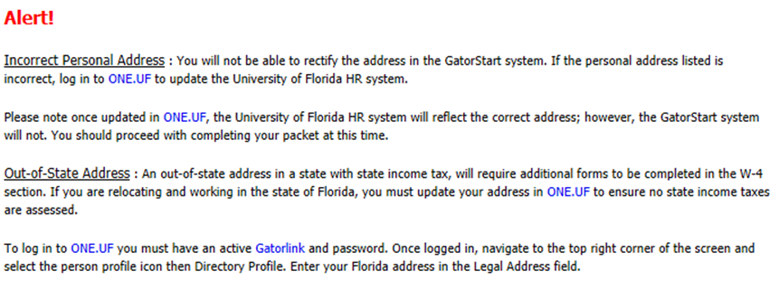
Gatorstart Name/address
Incorrect Address
IFAS HR can correct this if the individual has not proceeded past the “Personal Information Page”. After they have proceeded past this page, the ePAF will need to be withdrawn and re-entered to generate a new packet. Once generated, the address can be updated.
Message within GatorStart about incorrect personal information for new employees:
Please reach out to new employees to make sure GatorStart is completed in a timely manner.

Slide 34
Correcting gatorstart email

Slide 35
Name errors
The UF Legal Name must match the Social Security Card.
If these do not match, please contact IFAS HR and we will correct.

Slide 36
Nepotism
A nepotism agreement is needed when employees working in the same college and are living together in the same household or related. Note: UF does not hire the minor children of employees
The form is located here: https://hr.ufl.edu/manager-resources/employment-operations-and-records/employment-of-relatives-petition/
Please send the form and supplementary documents to Janet Malphurs for processing.
If the employee answers the “Relatives working at UF” question on the OPS application, please ensure that the nepotism form has been completed. The approval process can be lengthy.
All supporting documents need to be sent to IFAS HR -Janet Malphurs as one PDF (after the department obtains the signatures of both employee’s and supervisors) with the nepotism form being the first document, then other supporting documents attached. Ensure that the Organizational Chart is recent and can be read. Highlight or put an *(asterisk) by the employee’s involved. If Question 6 is answered NO for recruitment, a justification document (in PDF format) indicating the reason that no recruitment was done is to be attached. Please make sure the contact information is listed on the form.
Reminder: OPS hires are not required to be posted but it is encouraged to post that position on a bulletin board within the unit or the unit’s website.

Slide 37
Nepotism
If the nepotism petition involves a faculty member, post doc associate or graduate assistant, the approval process could take longer than normal due to the request would go to UFHR and then to the Provost office.
The approval process could take from 7 to 14 days.
Do not enter the nepotism request in the portal that is listed on the UF HR website, that is done at the College level.
Once approved by UFHR an email will be sent to the contact person on the form indicating approval. That email will need to be attached with the HIRE ePAF. DO NOT upload the whole nepotism packet to the ePAF.

Slide 38
Job Data correction form (jdc)
The JDC form can be found here: jobdatacorrection.pdf (ufl.edu)
This form is used to request a correction in an employment record in myUFL when the change cannot be completed via an ePAF.
A common use of this form is when an employees start date is incorrect and needs to be updated.
This form CANNOT be used to reactivate an employment record that has been terminated. In that case, you will need to enter a hire ePAF.
Once the form has been filled out, please send the form to Janet Malphurs for processing.

Slide 39
60 Day retro form
The 60 day retro form can be found here: 60 Day Retro Form
This form is used to request approval to change an employee’s compensation and/or FTE in job data that would be retroactive 60 calendar days or more.
This form is required for all types of employees including OPS, TEAMs, Faculty, and Graduate Assistants.
This form needs to be completed and approved BEFORE the ePAF can be approved.
Once the form has been filled out, please send the form to Janet Malphurs for processing.

Slide 40
Job Requisitions Reminders
Ensure the position data is up to date before posting. If it needs to be updated, please submit an update position ePAF.
Ensure the salary meets the minimum of the pay grade. Salary information can be found here:
https://teams-titles.hr.ufl.edu/
The minimum time for posting a position is 7 days. If you are reposting a position, the minimum is 3 days.
Ensure that the “Advertisement Text” is in the correct format. There is a “Generate Description” button to reset the format if needed.

Slide 41
FLSA Minimum for exempt employees
Current FLSA Exempt Employee Minimum: $35,568
Employees must be paid at least $684 per week ($35,568 annually) in order to be exempt from overtime requirements. Importantly, annualizing an employee’s salary based on a partial FTE is not permitted for purposes of meeting the minimum required salary.

Slide 42
Contact information
Denise Bogart
Director, HR
dbogart@ufl.edu
Susan Hudson
Associate Director, HR
shudson@ufl.edu
Dana LeCuyer
HR Specialist III, Faculty Recruitment
dlecuyer@ufl.edu
Janet Malphurs
Manager HR
jmmalph@ufl.edu
Anthony Bowman
HR Specialist III, Processing
adbowman@ufl.edu
Katie Davison
HR Specialist III, Immigration
katie.davison@ufl.edu
Debbie Sellers
HR Gen II, Benefits
debbiesellers@ufl.edu
Haley Tsai
HR Gen II, Processing
haley.tsai@ufl.edu
Catherine Ciminillo
Employee Relations
crincim@ufl.edu

Slide 43
Questions?

