Slide 1

2025 Open Enrollment

Slide 2

2025 Open Enrollment
Monday, Oct 14 at 8:00am EST to Friday, Nov 1 at 6:00pm EST
Open Enrollment is your opportunity to make benefits changes for 2025
    Passive enrollment:
    Submit changes only
    Existing plans will remain in effect unless canceled
Make changes to State Benefits via People First
Make changes to UFSelect and GatorCare Benefits via myUFL
State of Florida and UFHR Benefits & Wellness Fair:
  Friday, Oct 11 from 9:00am to 2:00pm

Slide 3



Make sure you review:
Your current benefit elections
Did you get married or have a child?
Do you need disability or additional life insurance?
Does your child need orthodontia coverage?

Slide 4

Make sure you review:
Your mailing address in myUFL
Visit the Benefits website for instructions on how to update your contact information.
https://hr.ufl.edu/benefits/life-event/

Slide 5

Make sure you review:
Your beneficiaries for Life Insurance, HSA, Retirement
An instruction guide for changing beneficiaries is available at
https://hr.ufl.edu/benefits/enrollment-management/
Changes to state life insurance beneficiaries may be made through the Securian portal in your People First account.

Slide 6


What IS changing in 2025?
10/1/2024

Slide 7

What IS changing in 2025?
UF Select Voluntary Life & Disability
The Standard
  Employees are eligible for $300,000 guaranteed issue life insurance with no medical questions asked (even if previously declined)
  Spouses are eligible for $50,000 guaranteed issue life insurance with no medical questions asked (employee must be enrolled in employee life to enroll in spouse life)
  Any life amounts over the guaranteed issue will require medical questions
  Employees may enroll in a 30-day or 90-day disability plan with no medical questions asked (even if previously declined)
  These exceptions are only for Open Enrollment 2025

Slide 8
What IS changing in 2025?
Health Savings Accounts
  Maximum contribution increase
  Only available for those enrolled in the State HDHP
  $4,300 limit for individual coverage ($150 increase) includes State contribution amount of $500/year
  $8,550 limit for family coverage ($250 increase) includes State contribution of $1000/year
  $1000 additional amount for 55+

Slide 9
What IS changing in 2025?
Weight Management Program & Diabetes Management Program
  Must have been enrolled in the State PPO or HMO plan during 2024 and will be enrolled in 2025
  Limited to the first 2800 applicants for Weight Management and 2000 for Diabetes Management
  Application Period: October 28 – November 17

Slide 10
What IS changing in 2025?
Graduate Assistants Benefits
  Rate increase for employee only coverage and rate decrease for dependent coverage
  Minor plan design changes to GatorGradCare plan to include out of network coverage
  GAs can now enroll in UFSelect Eagles Dental and Humana Vision – 100% employee paid plans

Slide 11

What IS NOT changing in 2025?
10/1/2024

Slide 12

What IS NOT changing in 2025?
NO INCREASE to full-time employee state
health insurance premiums or GatorCare premiums (except GatorGrad Care)
NO CHANGE to any of the plan designs for all medical, dental, and vision plans (i.e. networks, deductibles, copays, etc.) with the exception of the HDHP deductibles going up from $1600/$3200 to $1650/$3300 per IRS requirements

Slide 13
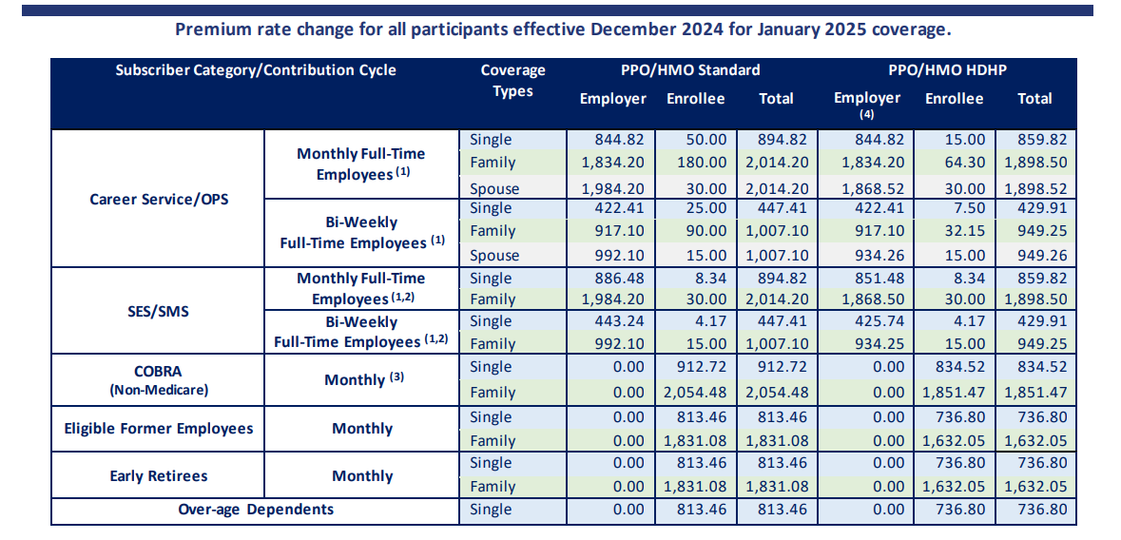
What IS NOT changing in 2025?

Slide 14


Slide 15


Health Insurance
State of Florida
Standard deductible PPO, no deductible HMO and high deductible HMO and PPO plans
University of Florida
GatorCare for postdoctoral associates, clinical faculty in the College of Medicine, residents, and faculty and staff who have domestic partners

Slide 16
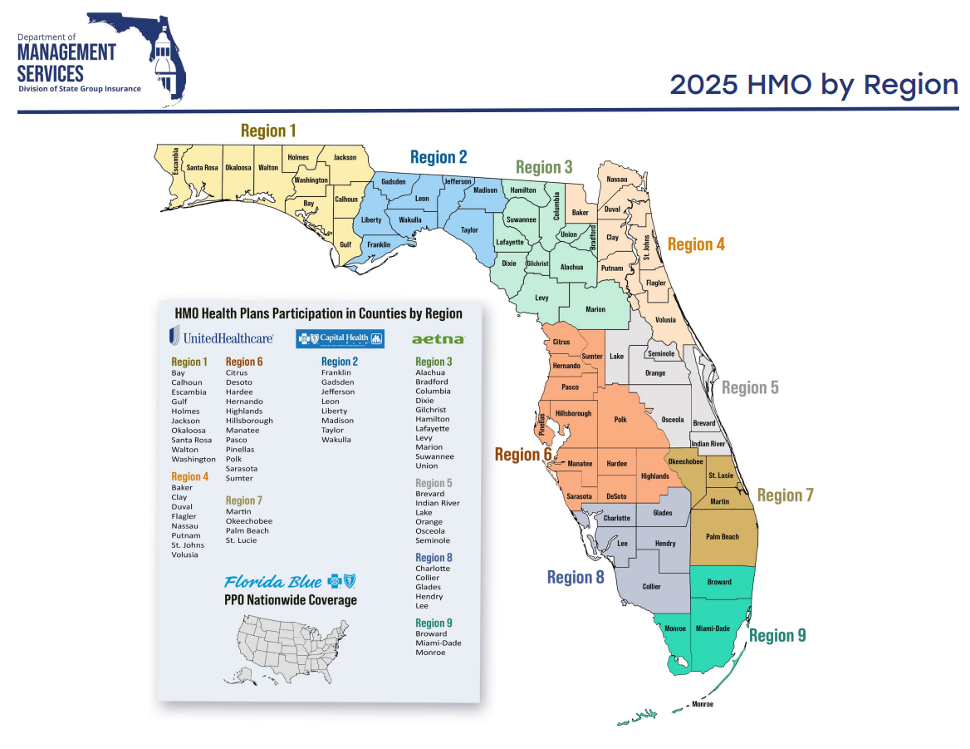

Slide 17

Dental Insurance
State of Florida
Many dental insurance options
University of Florida
Eagles Dental Reimbursement Plan

Slide 18
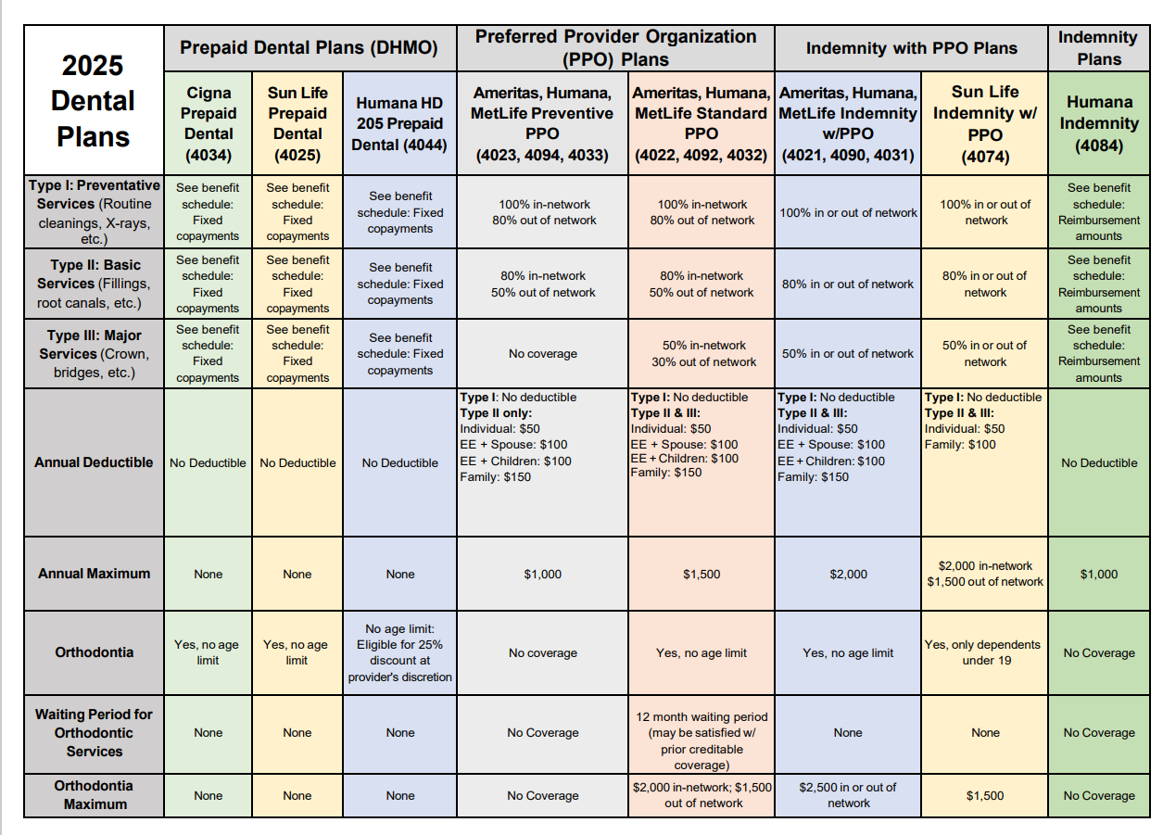

Slide 19

Supplemental Benefits
Life and Disability Insurance
State of Florida & UF: Life and disability insurance
Supplemental Insurances
State of Florida: Accident, Cancer, Hospitalization and Hospital Intensive Care
Savings Accounts
State of Florida: Healthcare Flexible Spending Account ($3200 max), Dependent Care Flexible Spending Account ($5000 max), Health Savings Account ($4300 / $8550)
Legal Plan
University of Florida: Preferred Legal Plan

Slide 20


Voluntary Savings Plans
UF Voluntary 403(b)
  Administered through Fidelity Investments
  Pre-tax & after-tax Roth options
  Enroll on the Fidelity Net Benefits website
State of Florida 457 Deferred Compensation Plan
  Administered through State of Florida
  Pre-tax & after-tax Roth options
  Several investment provider options
  Enroll on the State of Florida Deferred Compensation website
Eligibility & Contribution Limits
  All employees are eligible
  Can start, stop, or change contributions throughout the year
  2024 Limits: $23,000 under age 50 / $30,500 age 50 and over

Slide 21

Making

Slide 22

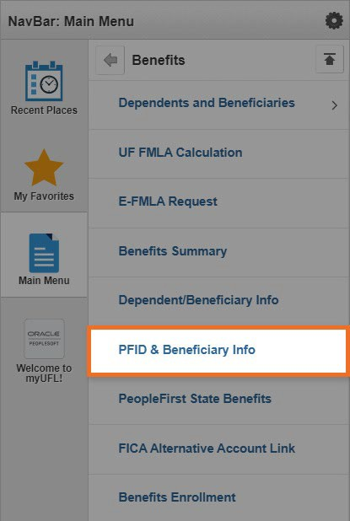
People First
peoplefirst.myflorida.com/peoplefirst
Find your People First ID Number:
myUFL >
Main Menu >
My Self Service >
Benefits >
PFID & Beneficiary Info

Slide 23
People First
peoplefirst.myflorida.com/peoplefirst
Help with login issues:
People First Service Center at 866-663-4735
Make changes over the phone:
People First Service Center at 866-663-4735
Enrollment Guide
https://www.mybenefits.myflorida.com/myhealth/eligibility_and_enrollment

Slide 24

Making

Slide 25

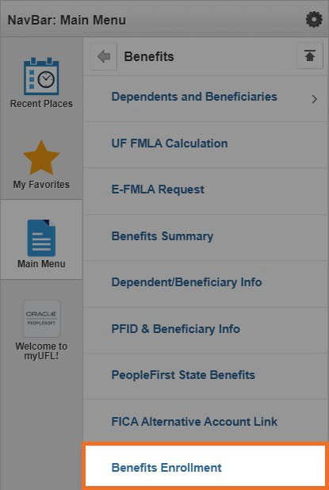
UFSelect and GatorCare
my.ufl.edu
UFSelect Benefits
myUFL > Main Menu >
My Self Service > Benefits > Benefits Enrollment
UFSelect benefits include: GatorCare, Eagles Dental, UF Vision, UF Term Life, Disability Benefits, and Legal Assistance

Slide 26


Slide 27

More Information
UFHR Benefits Website
State of Florida Open Enrollment Website
Benefits and Wellness Fair
Friday, October 11 from 9 a.m. to 2 p.m.
at the Champions Club

Slide 28



We can help!
Email us: benefits@ufl.edu
Book an appointment: https://hr.ufl.edu/benefits/support/
Call us: 352-392-2477, Option 2

