Slide 1
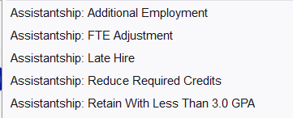
College Role in Graduate Student Employment Issues
Employment petitions
Late graduate assistantship hire (regular Fall 2023 hire by Aug. 16)
Petition accepted till Sept. 8
Indicate reason for late hire and the hire date
Hire at less than 0.25 FTE
Additional temporary assistantship employment
Graduate Assistant academic performance issues
If grades are the issue:
Petition to retain assistantship with below 3.0 GPA
Advisors check GIMS discrepancy reports as soon as grades are posted
If academic progress is the issue:
Help to develop detailed and time-specific academic improvement plans
General support and guidance
E.g., mentor-mentee conflicts, leave options, academic or employment issue?
Notes:
Arrival Deadlines for F-1 International Students
As a reminder, F-1 international students are expected to enter the United States prior to the program start date on their I-20. With an I-20 program start date in Spring 2023 through Summer A/C 2023 the students must enter the United States within:
15 days of the program start date on the I-20 for transfer-in F-1 students deadlines:
Tuesday, January 24, 2023 for Spring 2023
Tuesday, May 30, 2023 for Summer A/C 2023
30 days of the program start date on the I-20 for initial F-1 students deadlines:
Wednesday, February 8, 2023 for Spring 2023
Wednesday, June 14, 2023 for Summer A/C 2023

