Slide 1
Enterprise Analytics
Getting to Know Enterprise Analytics
December 2023

Slide 2
AGENDA
Introduction
Data Warehouse Overview
Permissions/Security
Review Enterprise Analytics Interface
Running a Report in Enterprise Analytics
Additional Resources
Q&A

Slide 3
INTRODUCTIONS
Notes:
Name
Have you used Enterprise Analytics and for how long
What do you primarily use EA for
Have you used Query Studio

Slide 4
Data Warehouse Overview

Slide 6
Permissions

Slide 7
Permissions
Report Permissions
Same roles from People Soft!
Some examples include (but not limited to):
UF_HR_VIEWINQUIRY
UF_EPAF_PAYROLL_OFFICE
UF_EPAF_EMPLOYMENT_OFFICE
UF_BN_BENEFITS_INQUIRY
UF_TL_DEPT_APPROVER/PROCESSOR
UF_PY_PAYROLL_INQUIRY
UF_PY_PAYROLL_SERVICES_STAFF
UF_PY_PAYROLL_SERVICES_ADMIN
UF_PY_PAYROLL_GARNISHMENTS
UF_LOA_VIEW
UF_KA_DEPT
UF_KA_DEPT_BUDGETING_ADMIN
….hundreds of ARS roles provide access to reports in Enterprise Analytics

Slide 8
Enterprise Reporting Navigation and Interface

Slide 9
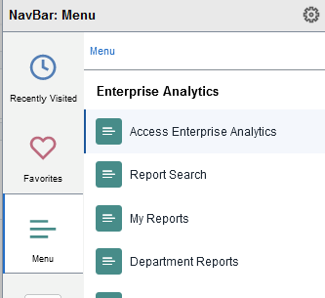
Review Report Author Interface
Accessing Enterprise Analytics
Login to myUFL with your Gatorlink username/password.
Navigate to: Main Menu >> Enterprise Analytics >> Access Enterprise Analytics
Notes:
More icon: context sensitive content depending on where you are in the system.
Bell icon: provides alerts for notifications (such as when a schedule report has been sent).
Person icon: set system preferences.
Question icon: access to the help system.

Slide 10
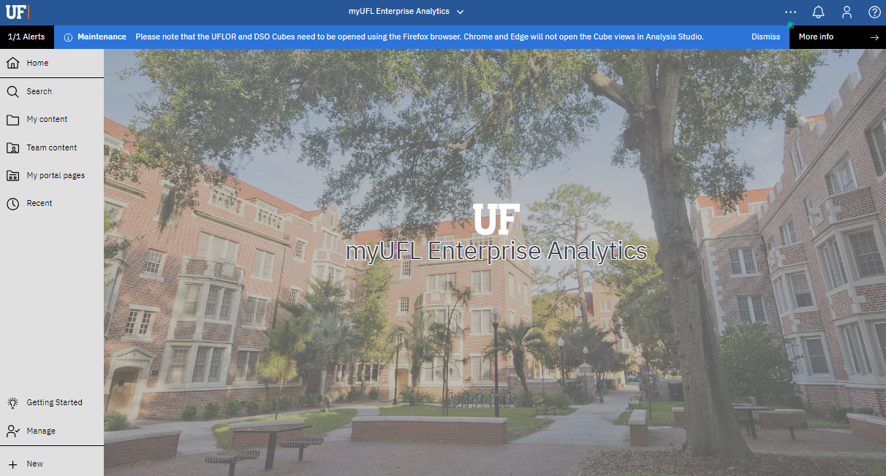
Review Report Author Interface
Left Navigation Menu:
Home: returns you to home screen
Search: search functionality
My content: personal folder for saving reports
Team content: contains the content you have access to based on your security role
Recent: most recently reviewed reports, data models, uploaded files
Getting Started: contains help videos
Manage: visible by system administrators. Used to create jobs.
New: used to create a new job or dashboard
Notes:
More icon: context sensitive content depending on where you are in the system.
Bell icon: provides alerts for notifications (such as when a schedule report has been sent).
Person icon: set system preferences.
Question icon: access to the help system.

Slide 11
Running Reports in Enterprise Analytics

Slide 12
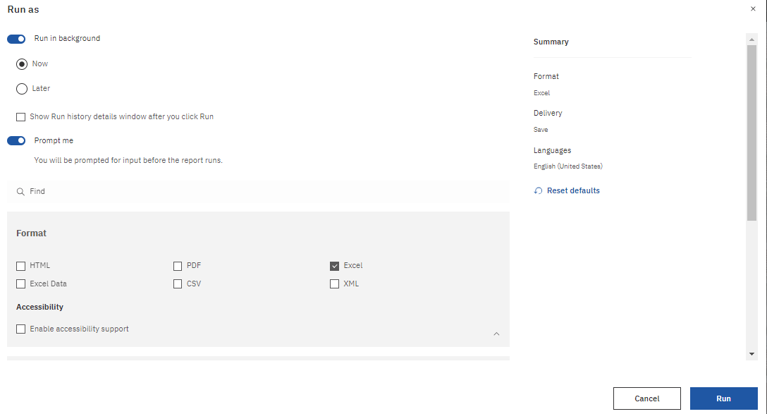
RUNNING REPORTS
Run Report with Default Options
To run a report in Enterprise Analytics, click on the report name.
Run Report with User Preferences
To run a report in Enterprise Analytics with your own preferences, use the ‘Run As’ option. This allows users to specify the file format, delivery options and runtime of the report.

Slide 13
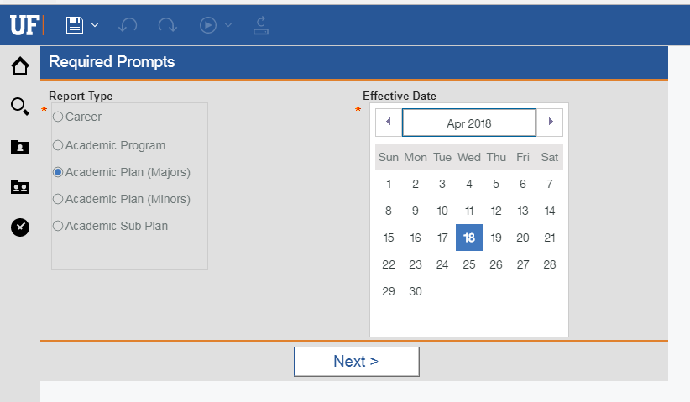
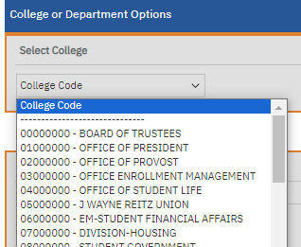
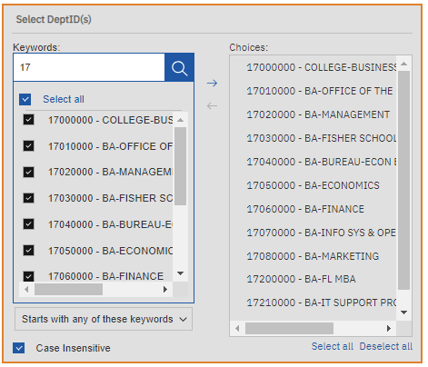
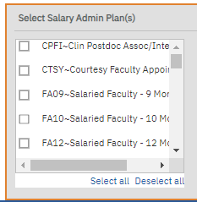
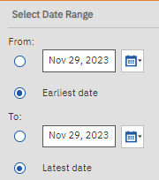
PROMPTS
Required vs Optional Prompts
Required Prompts – indicated by RED asterisk - you must make a selection
Optional Prompts – no specific indication, never ‘select all’ on an optional prompt, best to leave it unprompted/empty
Prompt Types
Checkbox – Select multiple options
List Box – Choose from options provided; one or more depending on report definition
Search and Select –Enter all/part of search text; select one or more values from result set; add them to ‘Choices’ box

Slide 14
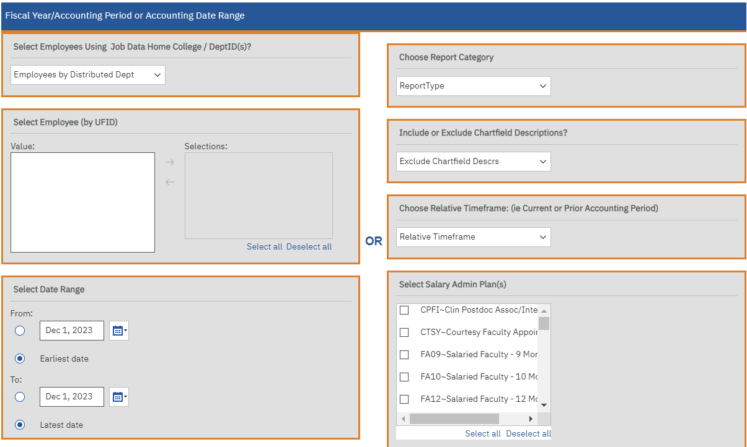
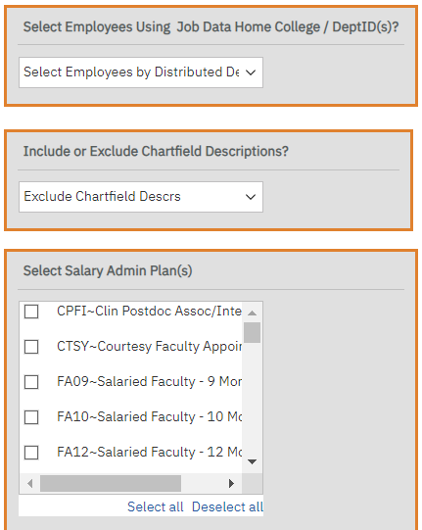
EXPORTING REPORTS
Payroll Distribution and Salary Related Reports
Team content > Financial Information > Comprehensive Financial Reporting Suite
Comprehensive Payroll Cost Distribution
Comprehensive Projected Payroll
Prompt options include College, Department, Fund, Source of Funds, Budget Reference, Dept Flex, EmplID Chartfield, Award ID, Award PI UFID, Project ID, Project Manager UFID
Payroll Cost Distribution vs Projected Payroll Prompts:

Slide 15
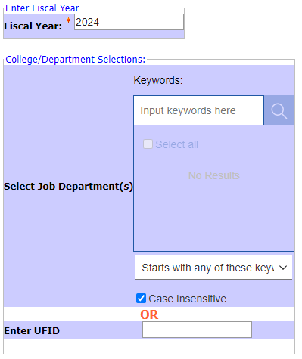
EXPORTING REPORTS
Payroll Distribution and Salary Related Reports
Team content > Human Resources Information > Pay Information > Current Pay Cycle > Prompted Cost Distribution Reports >
Department Budget Tables Sequences
Prompt options include Fiscal Year, Job Dept or Employee UFID
Team content > Human Resources Information > Pay Information > Current Pay Cycle
PY / HR Payroll Time and Labor
Prompt options include Date Range, DeptID(s), Supervisor UFID, Time and Labor Group, Exception Status, Approval Status, Employee UFID

Slide 16
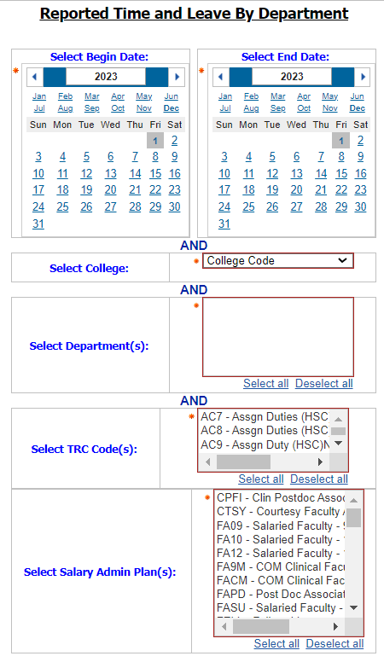
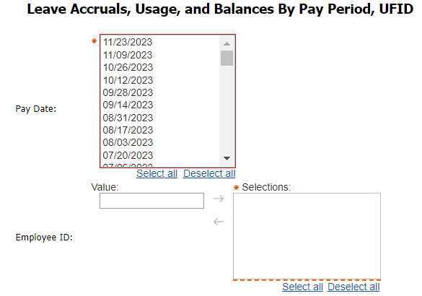
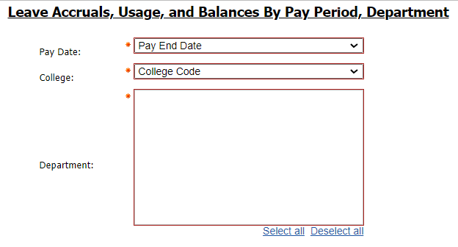
EXPORTING REPORTS
Leave Accruals and Usage
Team content > Human Resources Information > Benefit Information > Leave
Reported Time and Leave by Department
Leave Accruals, Usage, and Balances By PPE, EmpID
Leave Accruals, Usage, and Balances By PPE and Dept Listing
Leave Accruals, Usage, and Balances By Pay Period, Department
Leave Accruals, Usage, and Balances By Pay Period, Department – COMP Only
**** Must have one of the following to access: UF_BN_BENEFITS_ADMINISTRATOR,
UF_BN_BENEFITS_COORDINATOR, UF_BN_BENEFITS_ENROLLER, UF_BN_BENEFITS_INQUIRY

Slide 17
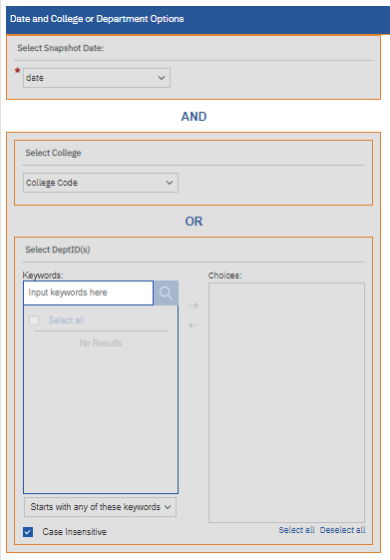
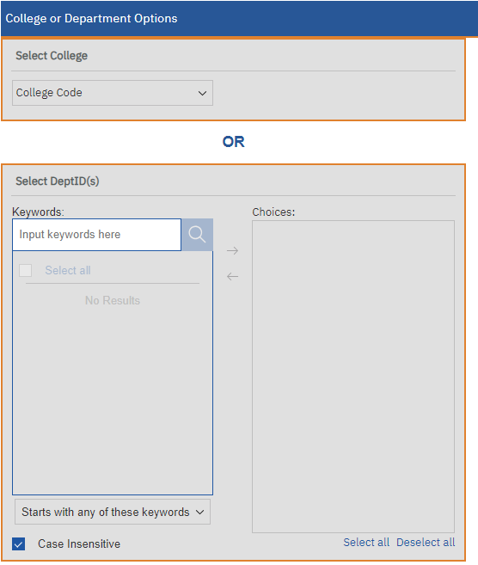
EXPORTING REPORTS
Other Well-Used HR Reports
Team content > Human Resources Information > Workforce Information:
Current Employee Details ** New Report!
based on current employees as of midnight, Job Data Department
Employees Assigned to a Department
Department based on Payable Time Department
Staff List with Supervisor Info by Department
Based on Job Data Department
Historical Employee Details ** New Report!
Based on Job Data Department, Snapshots taken

Slide 18
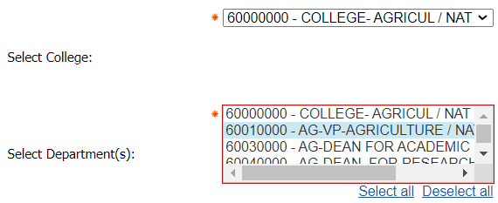
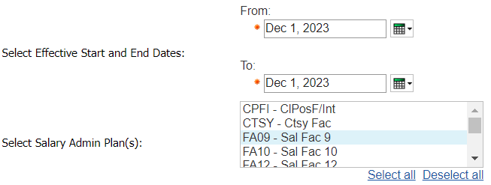
EXPORTING REPORTS
Other Well-Used HR Reports
Team content > Human Resources Information > Workforce Information:
New Hires By Department with Salary / New Hired by Salary Admin Plan
Prompts for college and date range
Terminations or Retirement By Department
Prompts for college and date range
Remote Work Location Agreements
Prompts for College or Depts, Approval Status,
Begin/End Date Range, Include Terminated or Transferred Empl?

Slide 19
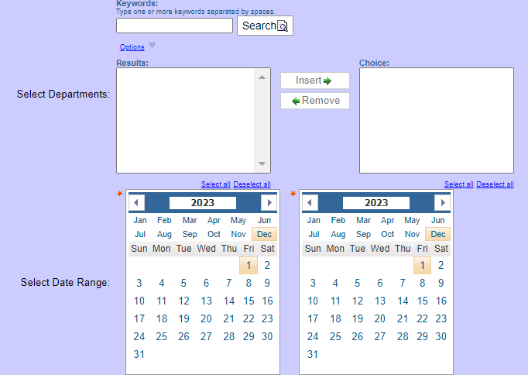
EXPORTING REPORTS
Reporting Scenario Discussion – Still Under Development
Scenario – pulling a list of current employees, hires and terminations for a given timeframe
Team content > Human Resources Information > Workforce Information:
New Hires By Department with Salary / New Hired by Salary Admin Plan
Terminations or Retirement By Department
Job Data Change by Department – not public at this time but will discuss with HR Core Office
pulls all job data changes for DeptID(s) and date ranges entered on prompt page

Slide 20
ADDITIONAL RESOURCES

Slide 21
ADDITIONAL RESOURCES
HR Reports:
https://hr.ufl.edu/manager-resources/hr-data-services-people-analytics/data-reports/
FI Reports:
https://www.fa.ufl.edu/directives/updated-reporting-tools/
Enterprise-Analytics-Basic-user-guide is available on the site under ‘Attachments’ section
HR Toolkits
https://learn-and-grow.hr.ufl.edu/toolkits-resource-center/enterprise-analytics/
HR Data Literacy Training – launching in MyTraining

