Slide 1


Slide 2

UFHR Strategic commitment
Help bring the strongest talent to UF via best practices and strategies … and improve the overall experience of candidates, new hires, and hiring authorities
  Design targeted onboarding approaches to help position new hires—both faculty and staff—for success
    Technology and readiness
    Welcome
    Sense of belonging

Slide 3
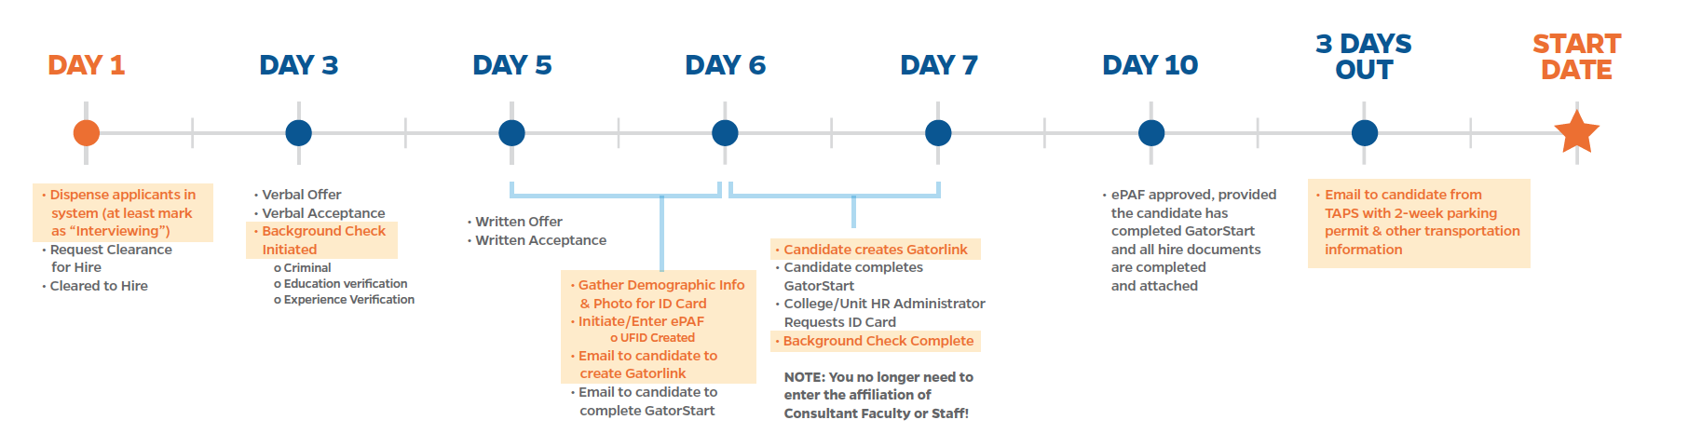
ONBOARDING TIMELINE

Slide 4

BACKGROUND SCREENING
UF is partnering with First Advantage to streamline the background screening process, which, in return, saves time for hiring departments when hiring a new employee.
Additional benefits include:
Hiring department will directly initiate the screening.
The requestor will receive a notification when:
  the invitation email is sent out
  a reminder email is sent out
  the screening is completed by First Advantage
All requestors can search for requests initiated by others to prevent duplication
(only see status).
Hiring department will be able to monitor the progress of the screening and view details of education and experience.
  Only Core HR will have the ability to review criminal background records.

Slide 5

BACKGROUND SCREENING
Screenings First Advantage will conduct:
  Criminal Background Check
    Local county check for past 10 years
  Education Verification
    Highest level of education (including High School Diploma)
  Experience Verification
    7 years of service
  Global Sanction (BASIC+Edu+Exp Verf Package)
The system will go live August 19th.

Slide 6
BACKGROUND SCREENING
Hiring department users who have either one of the following ePAF roles will be able to initiate a check in First Advantage.
  ePAF Originator
  ePAF Level 1 Approver
Navigation Background Screening can be found under UF Department Admin and Recruiting
Three packages
  Edu+Exp Verf
    New or returning salary/regular faculty, TEAMS, Adjuncts and PostDocs who underwent FBI or 434 Livescan outside of First Advantage
    OPS to Salary/Regular faculty, TEAMS, Adjuncts, and PostDocs
  Basic+Edu+Exp Verf
    Specifically for Salary/Regular Faculty, TEAMS, Adjuncts, and PostDoc
    Conducts criminal background check, global sanction lists, education verification, and experience verification
  Basic
    Specifically for OPS, Student employees, and graduate students
    Conducts criminal background check only

Slide 7
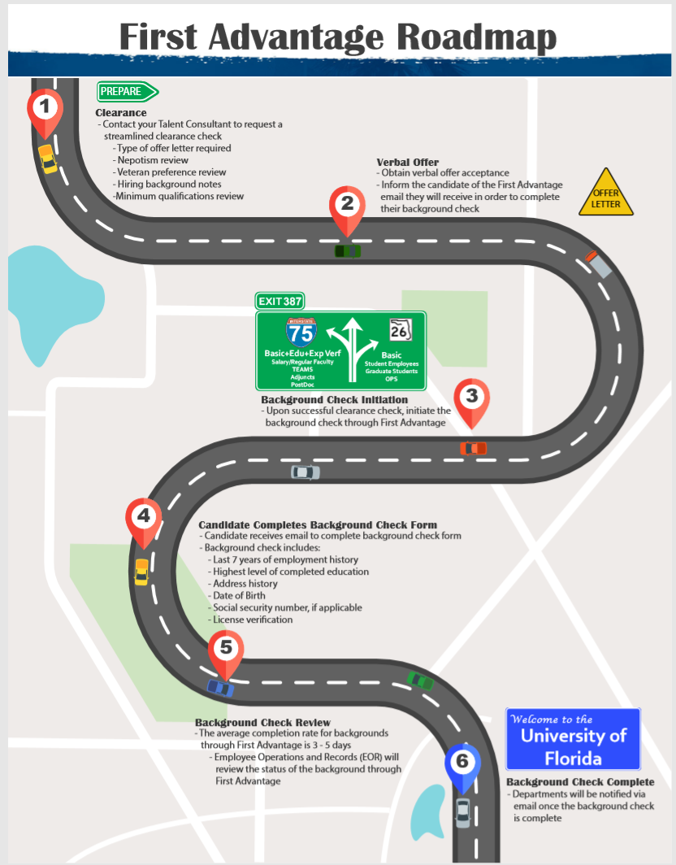
Resources
An instruction guide is upcoming and will be placed in the Prepare an Offer section of the Hiring Center under, Manager Resources, https://hr.ufl.edu/manager-resources/recruitment-staffing/hiring-center/preparing-an-offer/.
The instruction guide will include the First Advantage Roadmap.
Contact Talent Acquisition & Onboarding at 352-392-2477 or employment@ufl.edu regarding questions.

Slide 8

GATORLINK & EMAIL
To facilitate the creation of the Gatorlink and email, the affiliation of consultant-staff / consultant faculty is now automatically granted when a hire ePAF is initiated.
The benefits of this change include:
A Gatorlink invitation email will automatically be sent once the ePAF is initiated
HR department administrators will no longer need to add an affiliation prior to the hire ePAF approval
Once the Gatorlink is created by the new employee, the departmental IT will be able to set up the new employee’s email inbox

Slide 9
PARKING PERMITS
Body Heading
The Process
TAPS will run a query for new hires 3 days prior to the employee start date.
TAPS will email a welcome letter and temporary 2-week parking permit (attached as PDF) to each new hire.
Employees unintentionally missed in this process (i.e. emergency/late hires) may have their HR Administrator reach out to TAPS for assistance.
Body Heading
Notes
Emails/Permits will be personalized with employee name
Employees currently possessing an active decal will not be sent a welcome email
Job will run daily after close of business (Tentatively around 7PM)

Slide 10
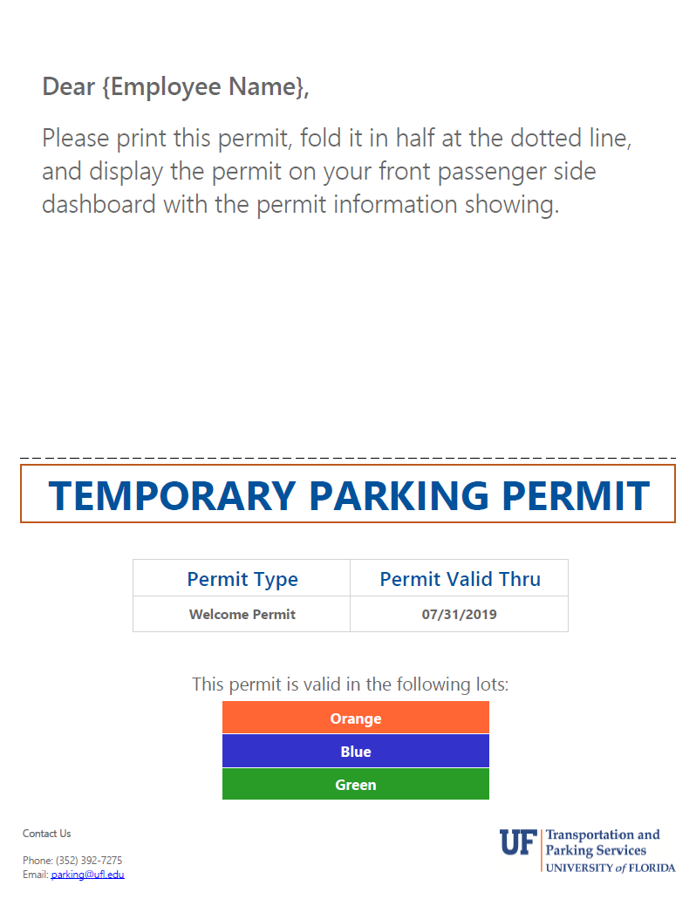
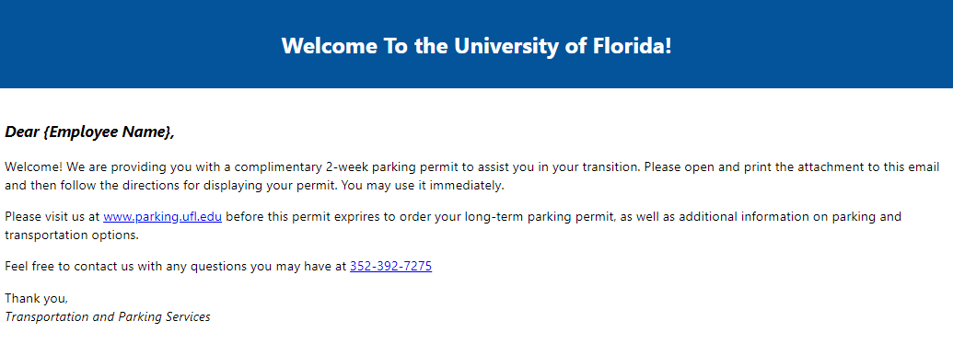
PARKING PERMITS
Body Heading
The Email and Permit
Body Heading

Slide 11
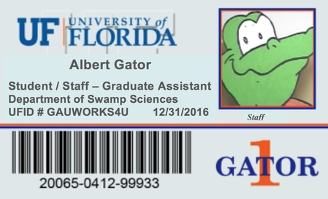
GATOR1 CARD
College/unit HR administrators request photo from new hire
College/unit HR administrators upload photo to Gator1 Central
Gator1 Card is printed and sent to the requestor (or other specified individual) via campus mail or regular mail if new hire is not in Gainesville

Slide 12
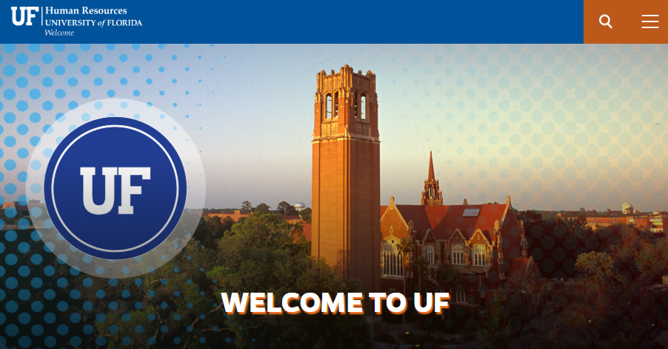
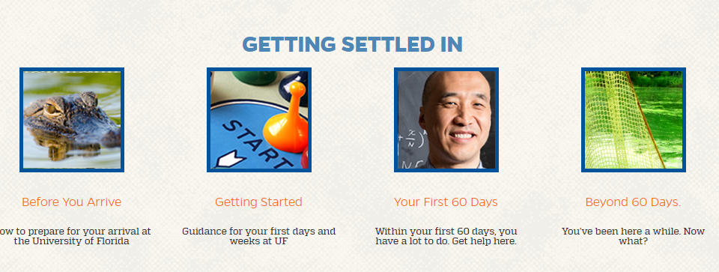
UFHR Welcome email and website
welcome.hr.ufl.edu

Slide 13

Onboarding 101 Toolkit
Visit the UFHR Hiring Center:
hr.ufl.edu/manager-resources/recruitment-staffing/hiring-center
Communication templates
Links to resources
Onboarding 101 PowerPoint

Slide 14
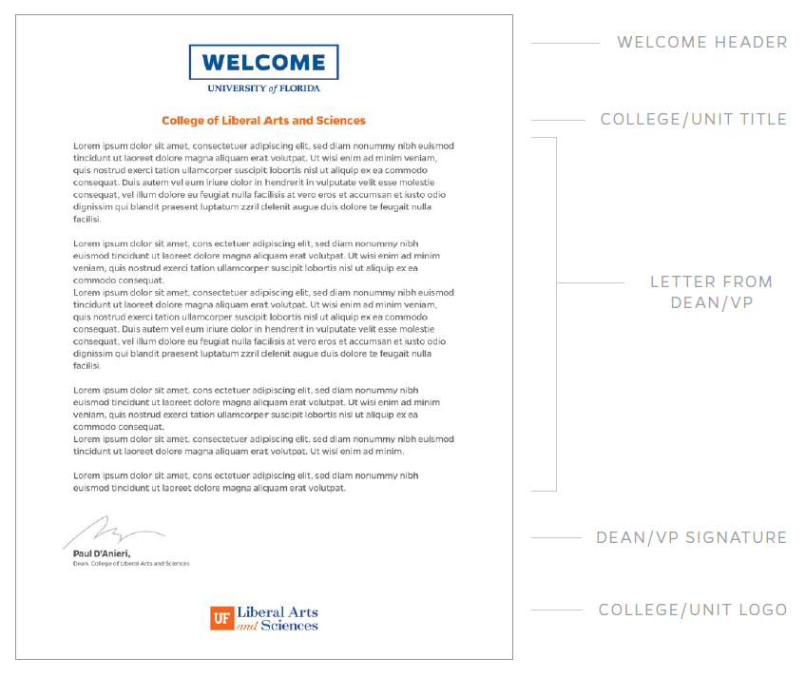
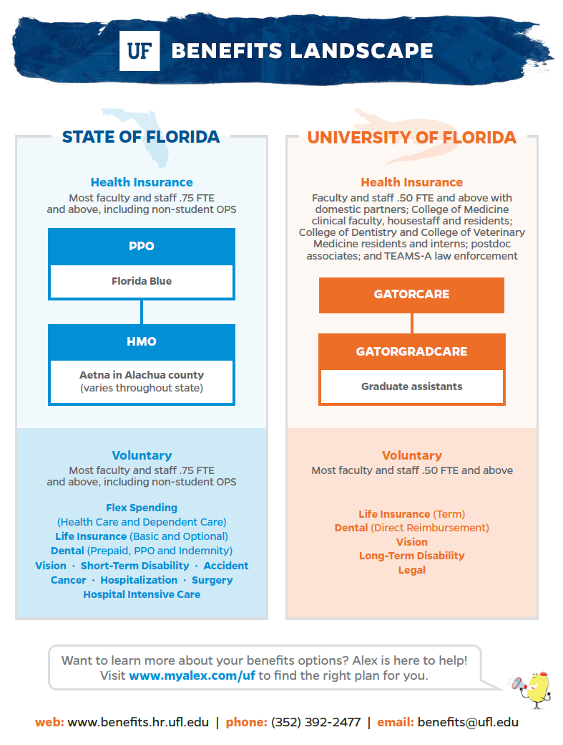
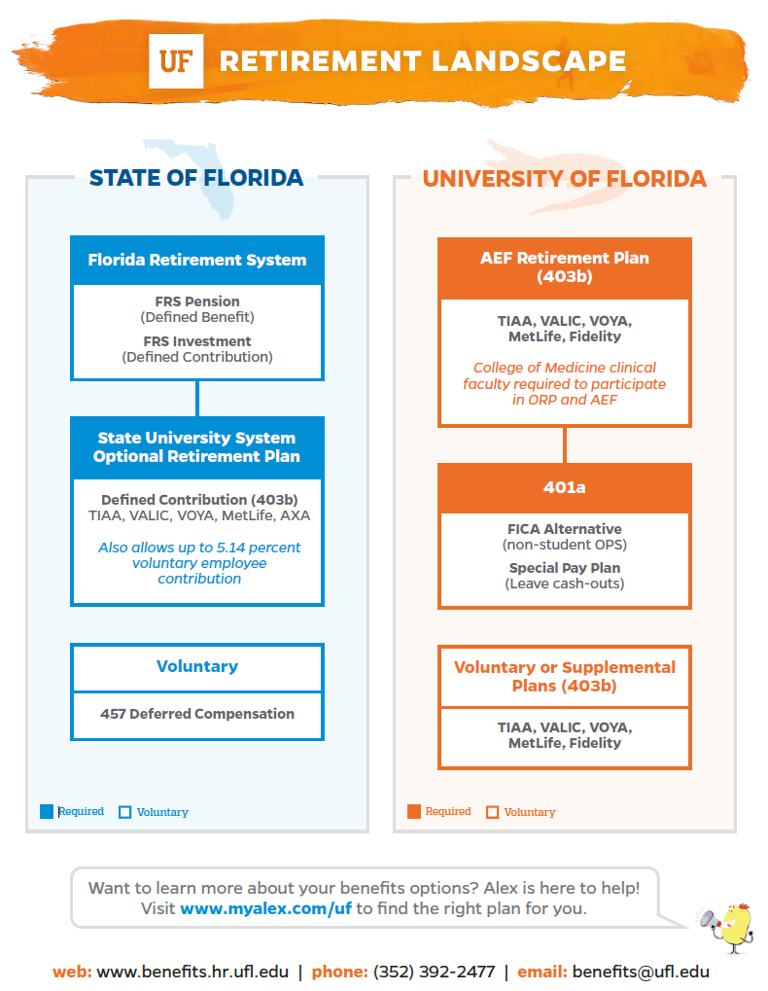
resources now available to download
Download these and more from the Onboarding 101 Toolkit. More details at the end of today’s session…

Slide 15


THANK YOU
WWW.HR.UFL.EDU

