Slide 1
FMLA ADMIN UPDATE PROJECT
Piloting a process developed through teamwork
WWW.HR.UFL.EDU

Slide 2
How did we get here?

Slide 3
Today was made possible by:
Ellen Young
Education
Lori Martin
PHHP
Elizabeth Moore
Pharmacy
Donna Stilwell Engineering
Leticia Forster
UFHR & IFAS
Anna Thrombley
UFIT
Melisa Smith
CLAS
Rebecca Wright
UFHR & Business Affairs
Vanessa Fayo
International Center
Jayne Defend
UFHR
Jason Talbert
UFHR
Jeremy
Lesifko-Bremer
UFHR

Slide 4
3 Day Kaizen Event
A specific process or problem is selected for analysis by a cross-functional team of people
A Kaizen Event is a very intensive and focused approach to Process Improvement (one tool)
The FMLA team followed a clearly defined 7-step process to get results, as you are about to see…
Creating a Culture of Continuous Improvement

Slide 5
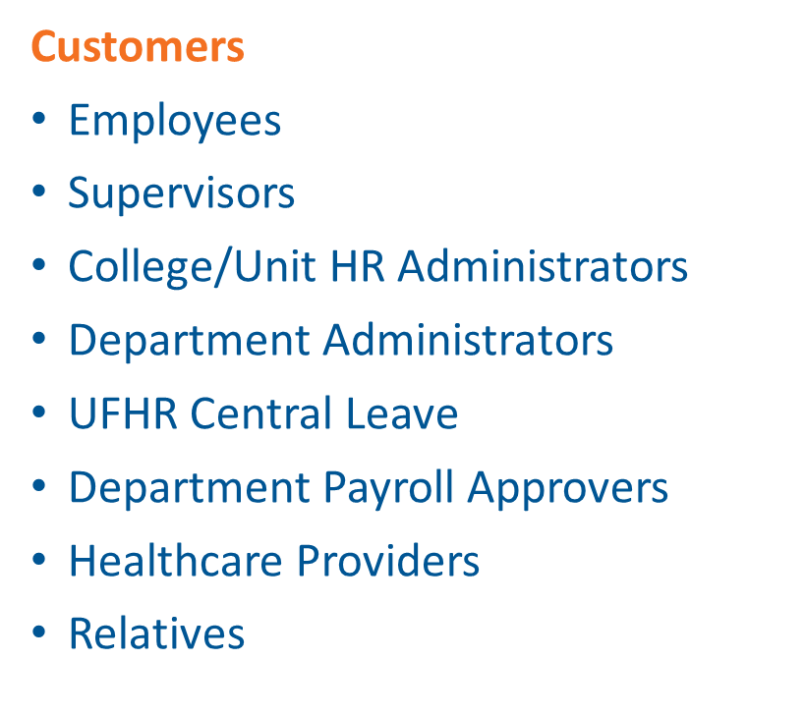
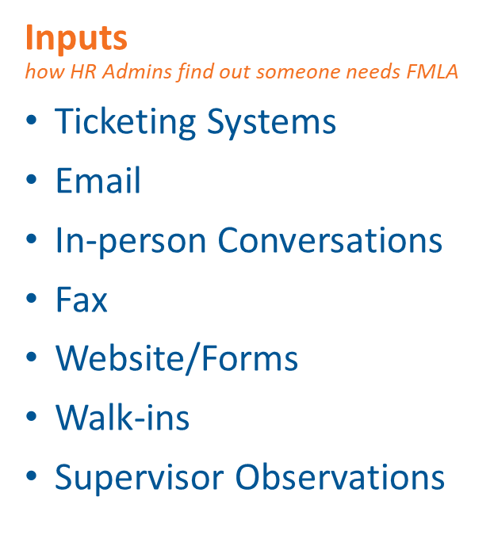
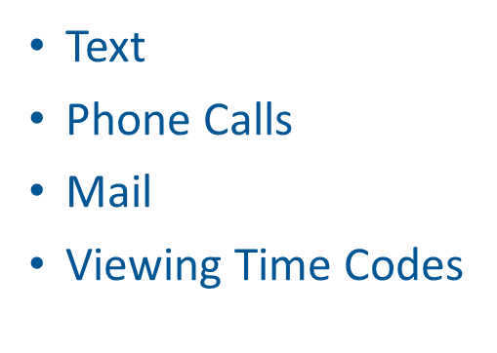
Customers → Inputs

Slide 6
Preliminary
Develop process maps for employees.
Develop process maps for department administrators.
Develop guidelines or maps for supervisors.
Develop guidance on how to manage multiple FMLA claims.
Develop guidance on the return to work steps.
Objectives
Measurable
Reduce process time
Compliance

Slide 7
FMLA Pilot Program
Pilot the Fall Semester
College of Pharmacy
College of Education
Depts in PHHP
Depts in Engineering
UFIT
Building Services
IFAS

Slide 8
Let’s see it!

Slide 9
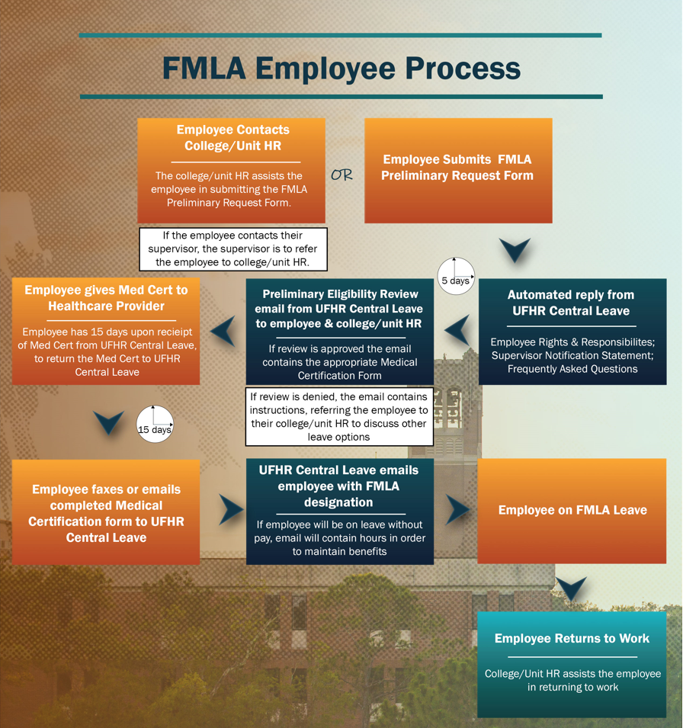

Slide 11
New and Improved Website:
https://benefits.hr.ufl.edu/time-away/fmla/

Slide 12
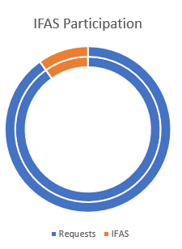
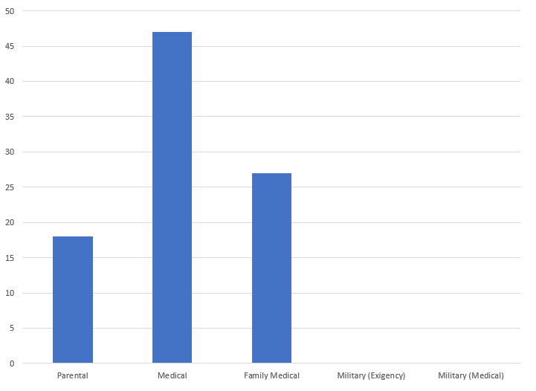
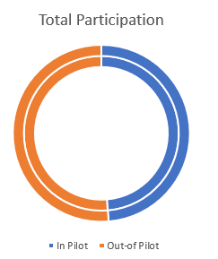
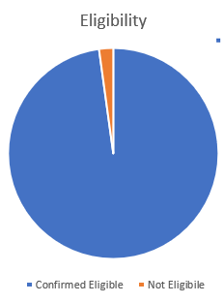
Preliminary Data (through 10/3/2019)

Slide 13
THANK YOU
WWW.HR.UFL.EDU

