Slide 1
2024 Open
Enrollment

Slide 2
2024 Open Enrollment
October 16 | 8:00am EST – November 3 | 6:00pm EST
Open enrollment is your opportunity to make benefits changes for 2024
Changes to State Benefits via People First
Changes to UF Select Benefits via myUFL
State of Florida and UFHR Benefits & Wellness Fair:
Friday, October 13 | 9:00am -2:00pm

Slide 3
Make sure you review:
Your address in MyUfl
Visit the Benefits website for instructions on how to update your contact information.
benefits.hr.ufl.edu/life-events/updating-directory

Slide 4
Make sure you review:
Your current benefit elections
Did you get married or have a child?
Did a child move away for college?
Does your child need orthodontia coverage?

Slide 5
Make sure you review:
Your beneficiaries
A toolkit for UF products is available at
benefits.hr.ufl.edu/my-benefits/enrollment
Resources regarding State beneficiaries are available through PeopleFirst.

Slide 6
4

Slide 7
What IS changing in 2024?
HMO Network
HMO plan services will be provided by Aetna, Capital Health Plan, or United Healthcare
Employees will default into the new HMO – no action required
Florida Blue is the PPO network for the State of Florida and is not changing
There are no plan design or rate changes
Important to confirm that current providers are in the network

Slide 8
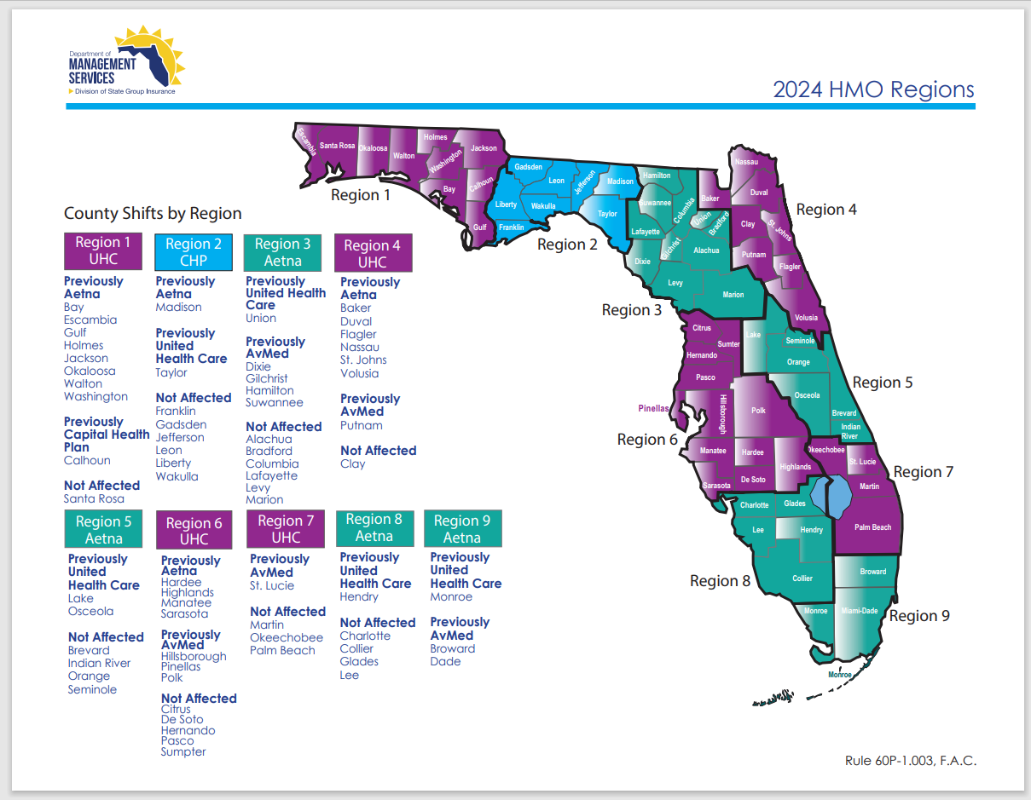

Slide 9
What IS changing in 2024?
Pharmacy Benefits Manager:
Optum Rx will replace CVS Caremark
Increased number of participating pharmacies (i.e. Walgreens, CVS, Publix, independent pharmacies)
New prescription cards will be issued and must be presented when refilling prescriptions
Effective mid November, employees can access the Optum Rx website to compare drugs, find information on prior authorization for specialty drugs, and get mail order information

Slide 10
What IS changing in 2024?
State Dental Plans
Decrease in Cigna Dental Premiums only
No plan design changes on any plans

Slide 11
What IS changing in 2024?
UF Select Vision Plan
Decrease in employee premiums for UF Select Humana Vision plan
State Humana vision plan remains the same cost

Slide 12
What IS changing in 2024?
State’s Health Savings Account Contributions
For those enrolled in the High Deductible Health Plans
State of Florida will continue to contribute monthly $41.66 for single coverage and $83.33 for family coverage
$4,150 limit for individual coverage ($300 increase)
$8,300 limit for family coverage ($550 increase)
Additional $1000 for participants who turn 55 prior to 12/31/24

Slide 13
4

Slide 14
What IS NOT changing in 2024?
NO INCREASE to employee State health insurance premiums

Slide 16
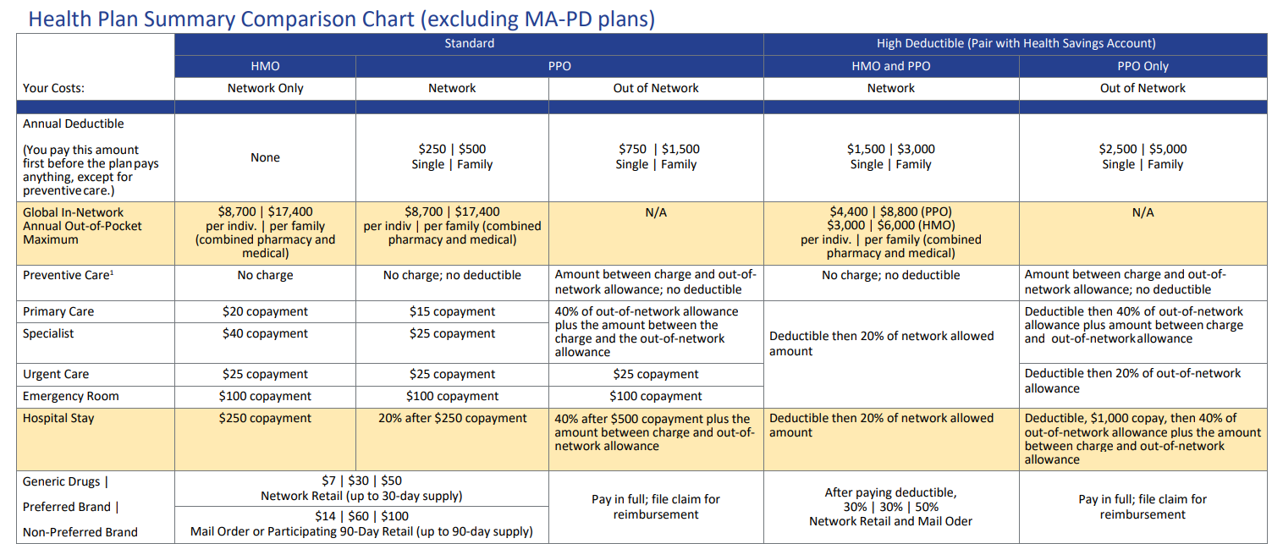
Health Insurance – State of Florida

Slide 17
Health Insurance
University of Florida
GatorCare is available for postdoctoral associates, clinical faculty in the College of Medicine, residents, and faculty and staff who have domestic partners
PPO medical plans
Florida Blue is the network of providers
Explore Your Benefits » GatorCare

Slide 18
Dental Insurance
State of Florida
Many dental insurance options
Traditional dental plans with a network of providers, deductibles and annual maximums
Some plans offer orthodontia coverage
University of Florida
Eagles Dental Plan
Dental reimbursement program
$1500 annual maximum
May go to any dentist

Slide 19
Supplemental Benefits
Life and Disability Insurance
State of Florida & UF: Life and disability insurance
Medical underwriting may be required
UF Life Insurance: The Standard
Incremental changes may be made regardless of your health during OE for the UF Life Insurance
Employee Life:
If currently enrolled for less than $800,000, may increase coverage by $10,000
If not enrolled, may enroll in $10,000.
Spouse Life:
If currently enrolled for less than $50,000, may increase coverage by $5,000.
If not enrolled, may enroll in $5,000.

Slide 20
Supplemental Benefits
State of Florida Supplemental Programs
Accident, Cancer, Hospitalization and Hospital Intensive Care
These plans pay directly to the member
State of Florida FSA or HSA
HSA is only available for those enrolled in the high deductible health plans
UF Preferred Legal Plan
Offers comprehensive legal assistance, advice and formal representation on all types of legal services
Coverage includes spouse, domestic partner, dependents and anyone living in the household
Low pay period costs - $4.98 for 24 pay periods

Slide 21
Voluntary Savings Plans
UF Voluntary 403(b)
Administered through Fidelity Investments
Pre-tax & After-tax Roth options
Enroll on the Fidelity Net Benefits website
All employees have an account set up
State of Florida 457 Deferred Compensation Plan
Administered through State of Florida
Several investment provider options
Enroll on the State of Florida Deferred Compensation website
Eligibility & Contribution Limits
All employees are eligible
Can start, stop or change throughout the year
2023 Limits - $22,500 under age 50 / $30,000 50 and over

Slide 23
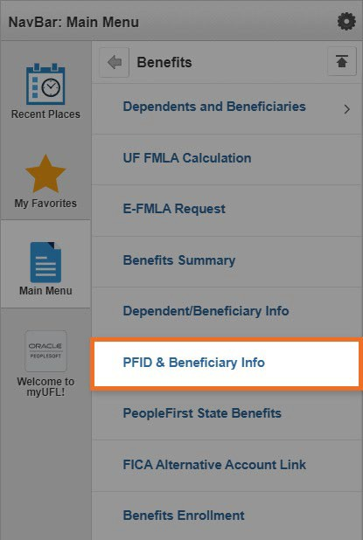
People First
peoplefirst.myflorida.com/peoplefirst
Find your People First ID Number:
myUFL >
Main Menu >
My Self Service >
Benefits >
PFID & Beneficiary Info

Slide 24
People First
peoplefirst.myflorida.com/peoplefirst
Contact the UFHR-Benefits Team for assistance with login issues
Make changes over the phone: People First Service Center at 866-663-4735
Enrollment Guide
www.mybenefits.myflorida.com/health
/eligibility_and_enrollment

Slide 26
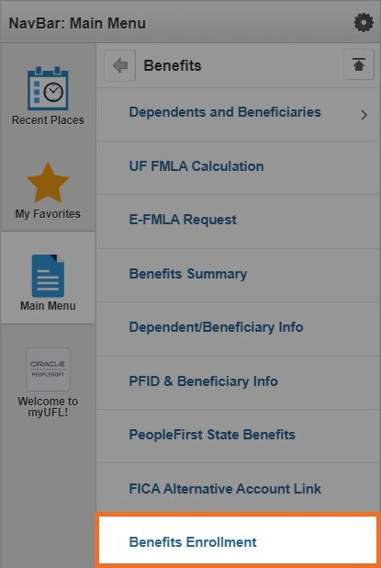
UF Select and GatorCare
my.ufl.edu
UF Select Benefits
myUFL > Main Menu >
My Self Service > Benefits > Benefits Enrollment
UF Select benefits include: GatorCare, Eagles Dental, UF Vision, Standard Optional Term Life and Disability Benefits

Slide 28
More Information
UFHR Website
benefits.hr.ufl.edu/my-benefits/open- enrollment
State of Florida Website
Open Enrollment for the 2024 Plan Year / Health | MyBenefits / Department of Management Services (myflorida.com)
Benefits and Wellness Fair October 13 from 9 a.m. to 2 p.m. at the Evans Champions Club at the Ben Hill Griffin Stadium

Slide 29
We can help!
Email us:
benefits@ufl.edu
Message us or book a phone/video consult: benefits.hr.ufl.edu/contact
Call us:
(352) 392-2477

Slide 30
Open Enrollment Reminders
Take Action
Check your mail for new Optum Rx card
Provide Optum Rx card to your pharmacist
Ensure 2024 benefits are correct in myUFL
Contact Benefits Team with any questions
Review
People First Confirmation Statement
Open Enrollment Website (UF & State)
Confirm
HMO Network / Physicians
Pharmacy Benefits Impact with Optum Rx
Enroll
State of Florida Benefits – People First
UF Plans – myUFL
No later than November 3 at 6pm EST

Slide 31
2024 Open
Enrollment
Notes:
Take care and thank you!

